Slide 1


北約國語宣道會
North York Mandarin Alliance Church
父親節聯合崇拜
Father’s Day Joint Worship
06月21日 | JUNE 21

Slide 2

詩篇 68:1-6
¹ 願神興起,使他的仇敵四散,叫那恨他的人從他面前逃跑.
² 他們被驅逐,如煙被風吹散;惡人見神之面而消滅,如蠟被火熔化.
³ 唯有義人必然歡喜,在神面前高興快樂.

Slide 3
詩篇 68:1-6
⁴ 你們當向神唱詩,歌頌他的名,為那坐車行過曠野的修平大路-他的名是耶和華,要在他面前歡樂！
⁵ 神在他的聖所做孤兒的父,做寡婦的申冤者.
⁶ 神叫孤獨的有家,使被囚的出來享福,唯有悖逆的住在乾燥之地。

Slide 4
Psalm 68:1-6
¹ May God arise, may his enemies be scattered; may his foes flee before him.
² May you blow them away like smoke—as wax melts before the fire, may the wicked perish before God.
³ But may the righteous be glad and rejoice before God; may they be happy and joyful.

Slide 5
Psalm 68:1-6
⁴ Sing to God, sing in praise of his name, extol him who rides on the clouds; rejoice before him—his name is the Lord.
⁵ A father to the fatherless, a defender of widows, is God in his holy dwelling.
⁶ God sets the lonely in families, he leads out the prisoners with singing; but the rebellious live in a sun-scorched land.

Slide 6

詩歌敬拜讚美主
Songs of Praise

Slide 7

將天敞開
Open Heaven
Sandy C. Yu | Tiffany Cheng
© 2012 Stream of Praise Music Ministries
CCLI License # 1052726

Slide 8

將天敞開 祢的榮耀降下來
jiāng tiān chǎng kāi ní de róng yào jiàng xià lái
Lord, release an open heaven and come down
將天敞開 祢的同在降下來
jiāng tiān chǎng kāi ní de tóng zài jiàng xià lái
Lord, release an open heaven and come down

Slide 9

將天敞開 祢的榮耀降下來
jiāng tiān chǎng kāi ní de róng yào jiàng xià lái
Lord, release an open heaven and come down
萬國讚嘆祢 祢是榮耀君王
wàn guó zàn tàn ní ní shì róng yào jūn wáng
May the nations sing, You're the glorious King

Slide 10
天上地下 合一敬拜
Tiān shàng dì xià hé yī jìng bài
Heaven and earth will join as one
歡呼 耶穌基督 聖潔羔羊 榮耀歸於祢
Huān hū yē sū jī dū sheng jié gāo yáng róng yào guī yú ní
Singing Jesus Christ the Lamb of God is worthy of our praise

Slide 11
天上地下 在永恆裡敬拜
tiān shàng dì xià zài yǒng héng lǐ jìng bài
Heaven and earth singing everlasting praise
哈利路亞 哈利路亞
hā lì lù yà hā lì lù yà
Hallelujah, hallelujah

Slide 13
將天敞開 祢的榮耀降下來
jiāng tiān chǎng kāi ní de róng yào jiàng xià lái
Lord, release an open heaven and come down
將天敞開 祢的同在降下來
jiāng tiān chǎng kāi ní de tóng zài jiàng xià lái
Lord, release an open heaven and come down

Slide 14
將天敞開 祢的榮耀降下來
jiāng tiān chǎng kāi ní de róng yào jiàng xià lái
Lord, release an open heaven and come down
萬國讚嘆祢 祢是榮耀君王
wàn guó zàn tàn ní ní shì róng yào jūn wáng
May the nations sing, You're the glorious King

Slide 15
天上地下 合一敬拜
Tiān shàng dì xià hé yī jìng bài
Heaven and earth will join as one
歡呼 耶穌基督 聖潔羔羊 榮耀歸於祢
Huān hū yē sū jī dū sheng jié gāo yáng róng yào guī yú ní
Singing Jesus Christ the Lamb of God is worthy of our praise

Slide 16
天上地下 在永恆裡敬拜
tiān shàng dì xià zài yǒng héng lǐ jìng bài
Heaven and earth singing everlasting praise
哈利路亞 哈利路亞
hā lì lù yà hā lì lù yà
Hallelujah, hallelujah

Slide 17
神就在這裡 我們歡迎祢
shén jiù zài zhèlǐ wǒ men huān yíng ní
God is here with us, dwelling in this place
讓一切焦點轉向祢
ràng yī qiè jiao diǎn zhuǎn xiàng ní
Let our eyes be fixed on You

Slide 18
神就在這裡 我們歡迎祢
shén jiù zài zhèlǐ wǒ men huān yíng ní
God is here with us, dwelling in this place
寶座前敬拜不停息
bǎo zuò qián jìng bài bù tíng xī
We will give You the highest praise

Slide 19
將天敞開 祢的榮耀降下來
jiāng tiān chǎng kāi ní de róng yào jiàng xià lái
Lord, release an open heaven and come down
將天敞開 祢的同在降下來
jiāng tiān chǎng kāi ní de tóng zài jiàng xià lái
Lord, release an open heaven and come down

Slide 20
將天敞開 祢的榮耀降下來
jiāng tiān chǎng kāi ní de róng yào jiàng xià lái
Lord, release an open heaven and come down
萬國讚嘆祢 祢是榮耀君王
wàn guó zàn tàn ní ní shì róng yào jūn wáng
May the nations sing, You're the glorious King

Slide 21
天上地下 合一敬拜
Tiān shàng dì xià hé yī jìng bài
Heaven and earth will join as one
歡呼 耶穌基督 聖潔羔羊 榮耀歸於祢
Huān hū yē sū jī dū sheng jié gāo yáng róng yào guī yú ní
Singing Jesus Christ the Lamb of God is worthy of our praise

Slide 22
天上地下 在永恆裡敬拜
tiān shàng dì xià zài yǒng héng lǐ jìng bài
Heaven and earth singing everlasting praise
哈利路亞 哈利路亞
hā lì lù yà hā lì lù yà
Hallelujah, hallelujah

Slide 24
將天敞開
Open Heaven
Sandy C. Yu | Tiffany Cheng
© 2012 Stream of Praise Music Ministries
CCLI License # 1052726

Slide 25

It Really Is Amazing Grace
這就是奇妙恩典
David Crowder | Jonathan Smith | Phil Wickham
© 2026 Capitol CMG Genesis; Inot Music; sixsteps Music; Be Essential Songs; Cashagamble Jet Music; Phil Wickham Music; Simply Global Songs
CCLI License # 1052726

Slide 26

Amazing grace
How sweet the sound
That saved a wretch like me
奇异恩典 何等甘甜
我罪已得赦免

Slide 27
I once was lost
But now I’m found
Was blind but now I see
前我失喪今被尋回
瞎眼今得看見

Slide 28
Singing Hallelujah there’s no chains on me
Thank You Jesus You have set me free
高唱 哈利路亞 我不被捆綁
感謝耶穌 祢將我釋放

Slide 29
You welcomed me in called me by name
Was dead in my sin
Now I’m dancing on that grave
張開手歡迎 呼喚我名
曾死在罪中 如今與祢同復活

Slide 30
Hallelujah it really is amazing grace
哈利路亞 這就是奇异恩典

Slide 31
‘Twas grace that taught my heart to fear
And grace my fears relieved
如此恩典 使我敬畏
使我心得安慰

Slide 32
How precious did that grace appear
The hour I first believed
初信之時 即蒙恩惠
真是何等寶貴

Slide 33
Singing Hallelujah there’s no chains on me
Thank You Jesus You have set me free
高唱 哈利路亞 我不被捆綁
感謝耶穌 祢將我釋放

Slide 34
You welcomed me in called me by name
Was dead in my sin
Now I’m dancing on that grave
張開手歡迎 呼喚我名
曾死在罪中 如今與祢同復活

Slide 35
Hallelujah it really is amazing grace
哈利路亞 這就是奇异恩典

Slide 37
I’ll testify of what He did
He gave me life I’m born again
我要見證 祂的作為
祂賜給我 新的生命

Slide 38
My heart is free my soul is saved
It really is amazing grace
我心自由 我靈得救
這真的是奇妙恩典

Slide 39
I’ll testify of what He did
He gave me life I’m born again
我要見證 祂的作為
祂賜給我 新的生命

Slide 40
My heart is free my soul is saved
It really is amazing grace
我心自由 我靈得救
這真的是奇妙恩典

Slide 41
It really is it really is
It really is amazing grace
It really is it really is
這就是 這就是
這就是奇妙恩典
這就是 這就是

Slide 42
Hallelujah there’s no chains on me
Thank You Jesus You have set me free
高唱 哈利路亞 我不被捆綁
感謝耶穌 祢將我釋放

Slide 43
You welcomed me in called me by name
Was dead in my sin
Now I’m dancing on that grave
張開手歡迎 呼喚我名
曾死在罪中 如今與祢同復活

Slide 44
Hallelujah it really is amazing grace
哈利路亞 這就是奇异恩典

Slide 45
It really is it really is
It really is amazing grace
這就是 這就是
這就是奇妙恩典

Slide 46
It really is it really is
It really is amazing grace
這就是 這就是
這就是奇妙恩典

Slide 47
It Really Is Amazing Grace
這就是奇妙恩典
David Crowder | Jonathan Smith | Phil Wickham
© 2026 Capitol CMG Genesis; Inot Music; sixsteps Music; Be Essential Songs; Cashagamble Jet Music; Phil Wickham Music; Simply Global Songs
CCLI License # 1052726

Slide 48

This Is My Father’s World
這是天父世界
Tommy Walker
© 2012 McKinney Music, Inc. (BMI)
CCLI License # 1052726

Slide 49

This is my Father's world and to my list'ning ears
All nature sings and 'round me rings
The music of the spheres
這是天父世界，我們側耳靜聽，
宇宙唱歌，四圍響應，星辰作樂同聲。

Slide 50
This is my Father's world I rest me in the thought
Of rocks and trees of skies and seas
His hand the wonders wrought
這是天父世界，我心滿有安寧，
花草樹木，穹蒼碧海，述說天父奇能！

Slide 51
這是天父世界，群鳥歡唱齊鳴，
zhè shì tiān fù shì jiè, qún niǎo huān chàng qí míng,
清晨明亮，百花美麗，
qīng chén míng liàng, bǎi huā měi lì,
證明創造精深。
zhèng míng chuàng zào jīng shēn.
This is my Father's world the birds their carols raise
The morning light the lily white declare their Maker's praise

Slide 52
這是天父世界，祂愛普及萬千，
zhè shì tiān fù shì jiè, tā ài pǔ jí wàn qiān
風吹草聲，知祂經過，
fēng chuī cǎo shēng, zhī tā jīng guò,
隨處能聽祂言。
suí chù néng tīng tā yán
This is my Father's world He shines in all that's fair
In the rustling grass I hear Him pass He speaks to me everywhere

Slide 53
This is my Father's world O let me ne'er forget
That though the wrong seems oft so strong
God is the Ruler yet
這是天父世界，叫我不可遺忘，
黑暗勢力雖然猖狂，天父卻仍作王。

Slide 54
This is my Father's world the battle is not done
Jesus who died shall be satisfied
And earth and heav'n be one
這是天父世界，我心不必憂傷，
天父是王，宇宙同唱，祂治萬國萬方。

Slide 55
I have a Father, He is my Father
He reigns in power and in love
我有一位天父，他是我的天父
以能力慈爱，掌管万有

Slide 56
I have a Father, my glorious Father
Creator, Master, King my God
我有一位天父，荣耀的天父
创造者，掌管者，他是我主我王

Slide 57
We have a Father, He is our Father
He reigns in power and in love
我们有一位天父，他是我们的天父
以能力慈爱，掌管万有

Slide 58
We have a Father, our glorious Father
Creator, Master, King my God
我们有一位天父，荣耀的天父
创造者，掌管者，他是我主我王

Slide 59
這是天父世界，叫我不可遺忘，
zhè shì tiān fù shì jiè, jiào wǒ bùkě yí wàng,
黑暗勢力雖然猖狂，
hēi àn shì lì suī rán chāng kuáng,
天父卻仍作王。
tiān fù què réng zuò wáng.
This is my Father's world O let me ne'er forget
That though the wrong seems oft so strong God is the Ruler yet

Slide 60
This Is My Father’s World
這是天父世界
Tommy Walker
© 2012 McKinney Music, Inc. (BMI)
CCLI License # 1052726

Slide 61
禱告
Prayer

Slide 62

讀經
Scripture Reading

Slide 63
路加福音 15:11-24
¹¹ 耶穌又說：「一個人有兩個兒子。¹² 小兒子對父親說：『父親，請你把我應得的家業分給我。』他父親就把產業分給他們。¹³ 過了不多幾日，小兒子就把他一切所有的都收拾起來，往遠方去了。在那裡任意放蕩，浪費資財。

Slide 64
路加福音 15:11-24
¹⁴ 既耗盡了一切所有的，又遇著那地方大遭饑荒，就窮苦起來。¹⁵ 於是去投靠那地方的一個人，那人打發他到田裡去放豬。¹⁶ 他恨不得拿豬所吃的豆莢充飢，也沒有人給他。¹⁷ 他醒悟過來，就說：『我父親有多少的雇工，口糧有餘，我倒在這裡餓死 嗎？

Slide 65
路加福音 15:11-24
¹⁸ 我要起來，到我父親那裡去，向他說：「父親，我得罪了天，又得罪了你。 ¹⁹ 從今以後，我不配稱為你的兒子，把我當做一個雇工吧！」』 ²⁰ 於是起來，往他父親那裡去。相離還遠，他父親看見，就動了慈心，跑去抱著他的頸項，連連與他親嘴。

Slide 66
路加福音 15:11-24
²² 父親卻吩咐僕人說：『把那上好的袍子快拿出來給他穿，把戒指戴在他指頭上，把鞋穿在他腳上，²³ 把那肥牛犢牽來宰了，我們可以吃喝快樂！²⁴ 因為我這個兒子是死而復活，失而又得的。』 他們就快樂起來。

Slide 67
Luke 15:11-24
¹¹ Jesus continued: “There was a man who had two sons. ¹² The younger one said to his father, ‘Father, give me my share of the estate.’ So he divided his property between them.
¹³ “Not long after that, the younger son got together all he had, set off for a distant country and there squandered his wealth in wild living.

Slide 68
Luke 15:11-24
¹⁴ After he had spent everything, there was a severe famine in that whole country, and he began to be in need. ¹⁵ So he went and hired himself out to a citizen of that country, who sent him to his fields to feed pigs. ¹⁶ He longed to fill his stomach with the pods that the pigs were eating, but no one gave him anything.

Slide 69
Luke 15:11-24
¹⁷ “When he came to his senses, he said, ‘How many of my father’s hired servants have food to spare, and here I am starving to death! ¹⁸ I will set out and go back to my father and say to him: Father, I have sinned against heaven and against you. ¹⁹ I am no longer worthy to be called your son; make me like one of your hired servants.’ ²⁰ So he got up and went to his father.

Slide 70
Luke 15:11-24
“But while he was still a long way off, his father saw him and was filled with compassion for him; he ran to his son, threw his arms around him and kissed him.
²¹ “The son said to him, ‘Father, I have sinned against heaven and against you. I am no longer worthy to be called your son.’

Slide 71
Luke 15:11-24
²² “But the father said to his servants, ‘Quick! Bring the best robe and put it on him. Put a ring on his finger and sandals on his feet. ²³ Bring the fattened calf and kill it. Let’s have a feast and celebrate. ²⁴ For this son of mine was dead and is alive again; he was lost and is found.’ So they began to celebrate.

Slide 72
金句
至於我和我家,
我們必定侍奉耶和華.
約書亞記 24:15b

Slide 73
Key Verse
But as for me and my household,
we will serve the Lord.
Joshua 24:15b

Slide 74

信仰的舵手
The Pilot of Faith
王靜泉長老
Elder Kevin Wang

Slide 75
信仰的舵手
6/21/2026

Slide 76


Slide 77
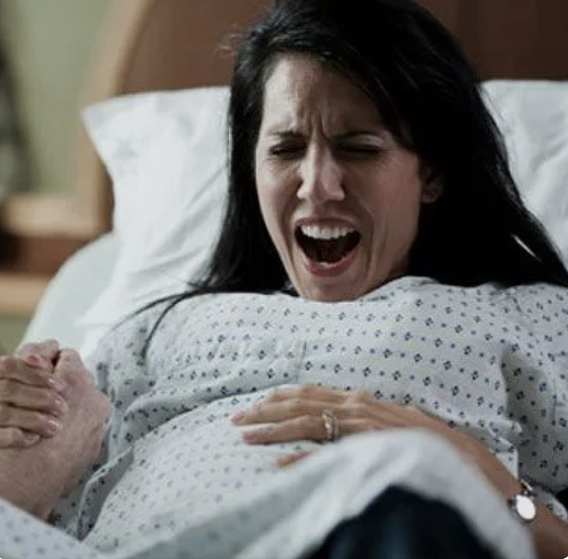
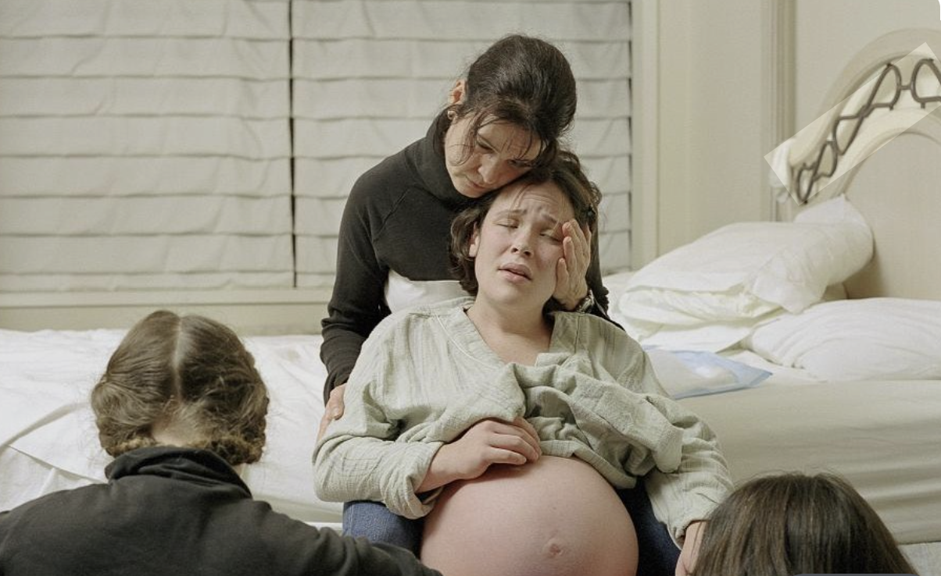
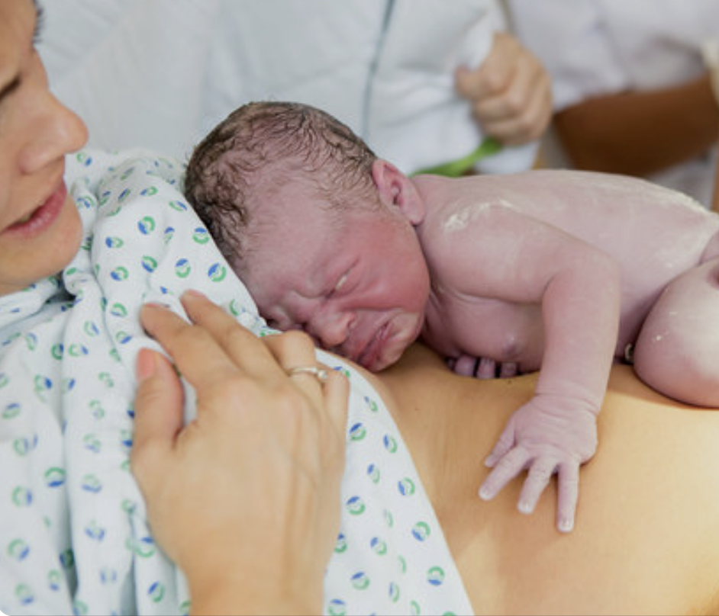

Slide 78
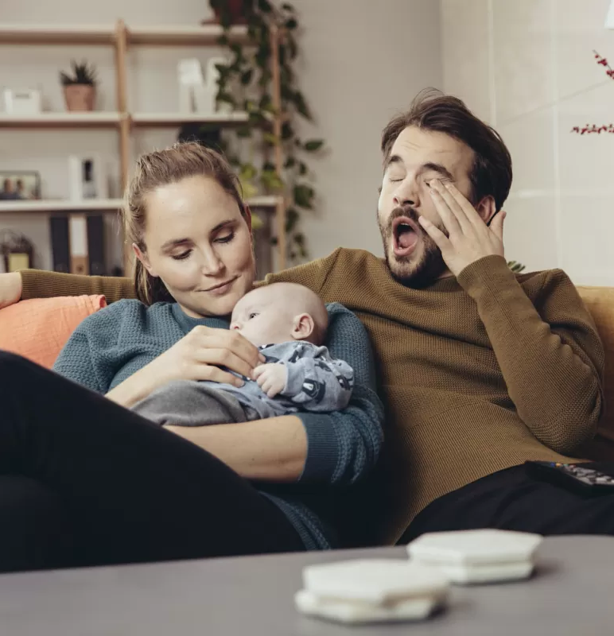

Slide 79
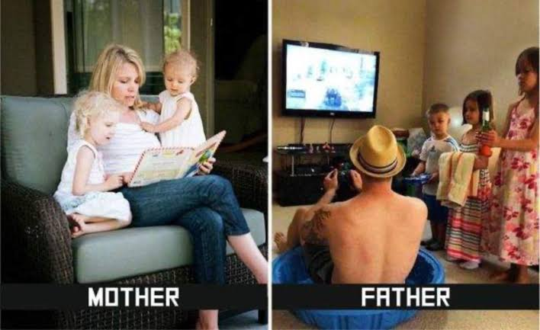
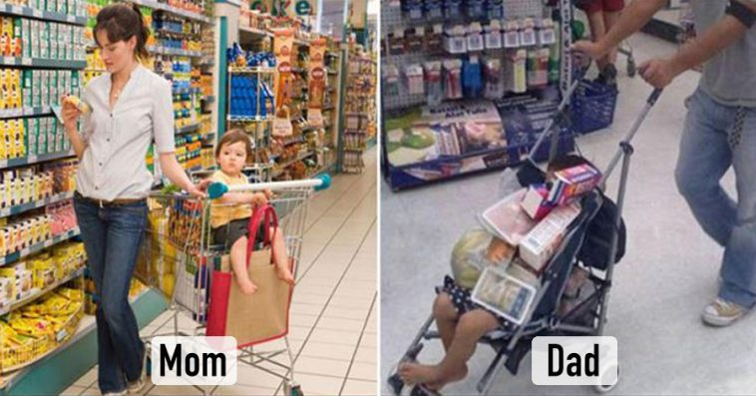

Slide 80
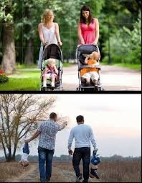
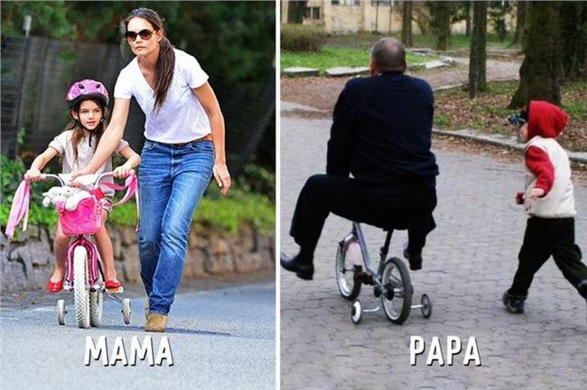

Slide 81
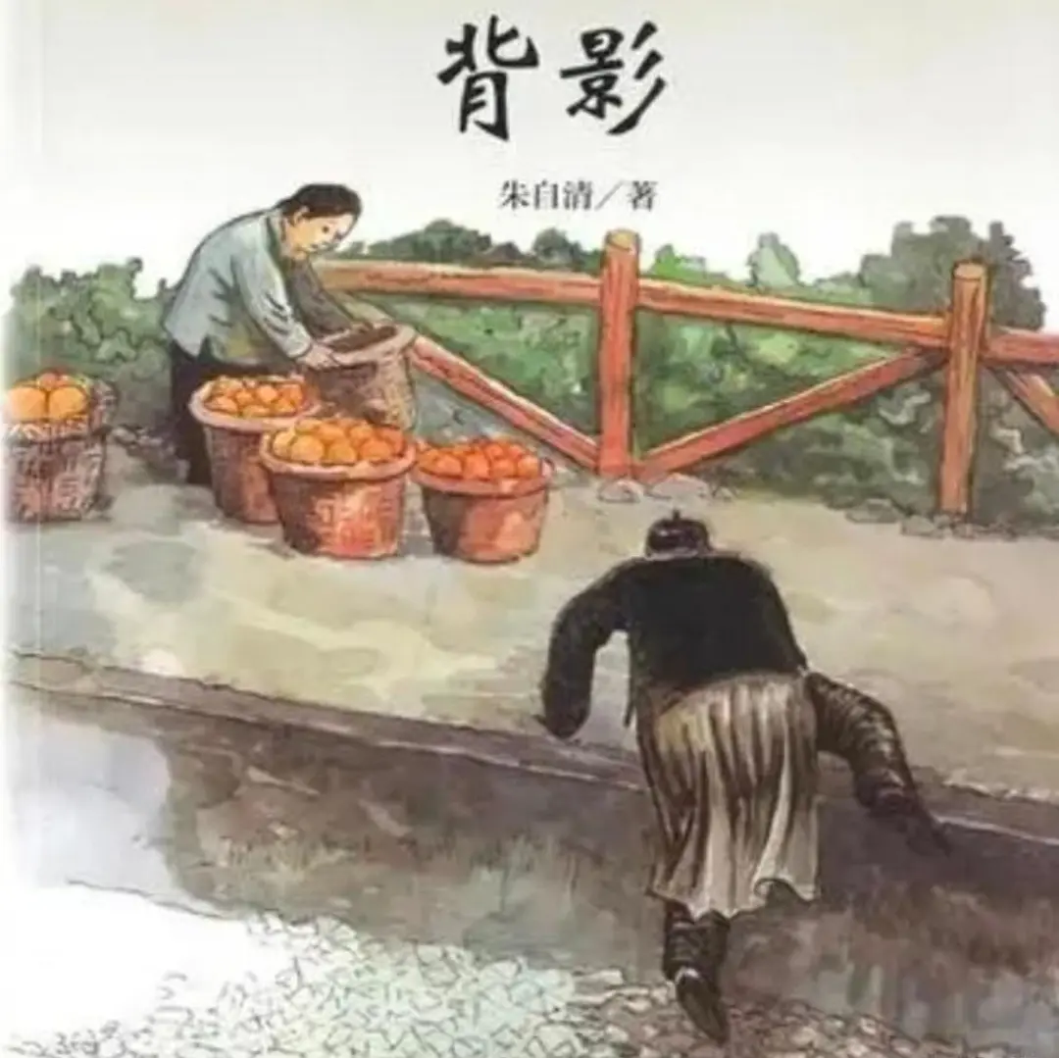
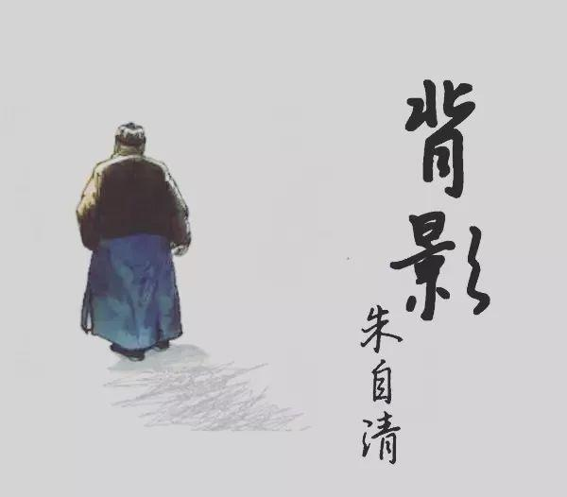
The Sight of My Father's Back - Zhu Ziqing

Slide 82
父親的角色 The role of a father
屬靈的領袖 The spiritual leader
若是你們以侍奉耶和華為不好，今日就可以選擇所要侍奉的，是你們列祖在大河那邊所侍奉的神呢，是你們所住這地的亞摩利人的神呢？至於我和我家，我們必定侍奉耶和華。」 約書亞記24:15
But if serving the Lord seems undesirable to you, then choose for yourselves this day whom you will serve, whether the gods your ancestors served beyond the Euphrates, or the gods of the Amorites, in whose land you are living. But as for me and my household, we will serve the Lord.” Joshua 24:15
他們說：「當信主耶穌，你和你一家都必得救。」他們就把主的道講給他和他全家的人聽。當夜，就在那時候，禁卒把他們帶去，洗他們的傷，他和屬乎他的人立時都受了洗。 於是禁卒領他們上自己家裡去，給他們擺上飯，他和全家因為信了神都很喜樂。 使徒行傳16:31-34
They replied, “Believe in the Lord Jesus, and you will be saved—you and your household.” 32 Then they spoke the word of the Lord to him and to all the others in his house. 33 At that hour of the night the jailer took them and washed their wounds; then immediately he and all his household were baptized. 34 The jailer brought them into his house and set a meal before them; he was filled with joy because he had come to believe in God—he and his whole household. Acts 16:31-34

Slide 83
父親的角色 The role of a father
屬靈的領袖 The spiritual leader
智慧和真理的教師 The teacher of Wisdom and Truth
我兒，要聽你父親的訓誨，不可離棄你母親的法則 箴言 1:8
Listen, my son, to your father’s instruction and do not forsake your mother’s teaching. Proverbs 1:8
我今日所吩咐你的話都要記在心上， 也要殷勤教訓你的兒女。無論你坐在家裡、行在路上，躺下、起來，都要談論。 申命記6:6-7
These commandments that I give you today are to be on your hearts. Impress them on your children. Talk about them when you sit at home and when you walk along the road, when you lie down and when you get up. Deuteronomy 6:6-7
懶惰人哪，你去察看螞蟻的動作，就可得智慧。 螞蟻沒有元帥，沒有官長，沒有君王， 尚且在夏天預備食物，在收割時聚斂糧食。懶惰人哪，你要睡到幾時呢？你何時睡醒呢？ 再睡片時，打盹片時，抱著手躺臥片時， 你的貧窮就必如強盜速來，你的缺乏彷彿拿兵器的人來到。 箴言 6:6-11
Go to the ant, you sluggard; consider its ways and be wise! It has no commander, no overseer or ruler, yet it stores its provisions in summer and gathers its food at harvest. How long will you lie there, you sluggard? When will you get up from your sleep? A little sleep, a little slumber, a little folding of the hands to rest and poverty will come on you like a thief and scarcity like an armed man. Proverbs 6:6-11

Slide 84
父親的角色 The role of a father
屬靈的領袖 The spiritual leader
智慧和真理的教師 The teacher of Wisdom and Truth
生命的榜樣 A Role Model in Life
行為純正的義人，他的子孫是有福的！ 箴言 20:7
The righteous lead blameless lives; blessed are their children after them. Proverbs 20:7

Slide 85
父親的角色 The role of a father
屬靈的領袖 The spiritual leader
智慧和真理的教師 The teacher of Wisdom and Truth
生命的榜樣 A Role Model in Life
愛中的管教者 A Loving Disciplinarian
不忍用杖打兒子的，是恨惡他；疼愛兒子的，隨時管教。 箴言13:24
Whoever spares the rod hates their children, but the one who loves their children is careful to discipline them. Proverbs 13:24
教養孩童，使他走當行的道，就是到老他也不偏離。 箴言22:6
Start children off on the way they should go, and even when they are old they will not turn from it. Proverbs 22:6
你們做父親的，不要惹兒女的氣，只要照著主的教訓和警戒養育他們。 以弗所書 6:4
Fathers, do not exasperate your children; instead, bring them up in the training and instruction of the Lord. Ephesians 6:4

Slide 86
父親的角色 The role of a father
屬靈的領袖 The spiritual leader
智慧和真理的教師 The teacher of Wisdom and Truth
生命的榜樣 A Role Model in Life
愛中的管教者 A Loving Disciplinarian
祝福與身份的給予者 A Giver of Blessing and Identity
猶大啊，你弟兄們必讚美你，你手必掐住仇敵的頸項，你父親的兒子們必向你下拜。 猶大是個小獅子。我兒啊，你抓了食便上去。你屈下身去，臥如公獅，蹲如母獅，誰敢惹你？ 圭必不離猶大，杖必不離他兩腳之間，直等細羅來到，萬民都必歸順。 創世記 49:8-10
“Judah, your brothers will praise you; your hand will be on the neck of your enemies; your father’s sons will bow down to you. You are a lion’s cub, Judah; you return from the prey, my son. Like a lion he crouches and lies down, like a lioness—who dares to rouse him? The scepter will not depart from Judah, nor the ruler’s staff from between his feet, until he to whom it belongs[d] shall come and the obedience of the nations shall be his. Genesis 49:8-10

Slide 87
父親的角色 The role of a father
屬靈的領袖 The spiritual leader
智慧和真理的教師 The teacher of Wisdom and Truth
生命的榜樣 A Role Model in Life
愛中的管教者 A Loving Disciplinarian
祝福與身份的給予者 A Giver of Blessing and Identity

Slide 88
浪子回頭 The Parable of the Lost Son
耶穌又說：「一個人有兩個兒子。 小兒子對父親說：『父親，請你把我應得的家業分給我。』他父親就把產業分給他們。 過了不多幾日，小兒子就把他一切所有的都收拾起來，往遠方去了。在那裡任意放蕩，浪費資財。 既耗盡了一切所有的，又遇著那地方大遭饑荒，就窮苦起來。於是去投靠那地方的一個人，那人打發他到田裡去放豬。他恨不得拿豬所吃的豆莢充飢，也沒有人給他。他醒悟過來，就說：『我父親有多少的雇工，口糧有餘，我倒在這裡餓死嗎？ 我要起來，到我父親那裡去，向他說：「父親，我得罪了天，又得罪了你。從今以後，我不配稱為你的兒子，把我當做一個雇工吧！」』 於是起來，往他父親那裡去。相離還遠，他父親看見，就動了慈心，跑去抱著他的頸項，連連與他親嘴。兒子說：『父親，我得罪了天，又得罪了你。從今以後，我不配稱為你的兒子。』 父親卻吩咐僕人說：『把那上好的袍子快拿出來給他穿，把戒指戴在他指頭上，把鞋穿在他腳上， 把那肥牛犢牽來宰了，我們可以吃喝快樂！ 因為我這個兒子是死而復活，失而又得的。』他們就快樂起來。 路加福音 15:11-24
Jesus continued: “There was a man who had two sons. The younger one said to his father, ‘Father, give me my share of the estate.’ So he divided his property between them. “Not long after that, the younger son got together all he had, set off for a distant country and there squandered his wealth in wild living. After he had spent everything, there was a severe famine in that whole country, and he began to be in need. So he went and hired himself out to a citizen of that country, who sent him to his fields to feed pigs. He longed to fill his stomach with the pods that the pigs were eating, but no one gave him anything. “When he came to his senses, he said, ‘How many of my father’s hired servants have food to spare, and here I am starving to death! I will set out and go back to my father and say to him: Father, I have sinned against heaven and against you. I am no longer worthy to be called your son; make me like one of your hired servants.’ So he got up and went to his father. “But while he was still a long way off, his father saw him and was filled with compassion for him; he ran to his son, threw his arms around him and kissed him. “The son said to him, ‘Father, I have sinned against heaven and against you. I am no longer worthy to be called your son.’ “But the father said to his servants, ‘Quick! Bring the best robe and put it on him. Put a ring on his finger and sandals on his feet. Bring the fattened calf and kill it. Let’s have a feast and celebrate. For this son of mine was dead and is alive again; he was lost and is found.’ So they began to celebrate. Luke 15: 11-24

Slide 89
「看哪，耶和華大而可畏之日未到以前，我必差遣先知以利亞到你們那裡去。 他必使父親的心轉向兒女，兒女的心轉向父親，免得我來咒詛遍地。」 瑪拉基書 4:5-6
“See, I will send the prophet Elijah to you before that great and dreadful day of the Lord comes. He will turn the hearts of the parents to their children, and the hearts of the children to their parents; or else I will come and strike the land with total destruction.” Malachi 4:5-6

Slide 90
回應詩歌
Response Song

Slide 91
回家
Coming Home
Sandy C. Yu
© 2013 Stream of Praise Music Ministries
CCLI License # 1052726

Slide 92

亲爱耶稣 我感谢祢来到这世界
qīn'ài yē sū wǒ gǎn xiè ní lái dào zhè shì jiè
My dear Jesus, I give You thanks for coming to this world.
给我盼望 给我一个永恒的家
gěi wǒ pàn wàng gěi wǒ yīgè yǒng héng de jiā
You've given me an everlasting home to love.

Slide 93
亲爱天父 轻声唤我回到祂面前
qīn'ài tiān fù qīng shēng huàn wǒ huí dào tā miàn qián
My dear Father, You call me once again back to You.
不再流浪 我看到家的光
bù zài liú làng wǒ kàn dào jiā de guāng
I see Your light, I’m coming back home.

Slide 94
回家 回家 回到永恒爱的家
huí jiā huí jiā huí dào yǒng héng ài de jiā
Coming home, coming home, back to my eternal home.
喜乐充满我的心 我不住赞美
xǐ lè chōng mǎn wǒ de xīn wǒ bù zhù zànměi
My heart is filled with praise and joy, I can’t stop singing.

Slide 95
回家 回家 回到永恒爱的家
huí jiā huí jiā huí dào yǒng héng ài de jiā
Coming home, coming home, back to my eternal home.
天父张开爱的双臂 我一生属于祂
tiān fù zhāng kāi'ài de shuāng bì wǒ yī shēng shǔ yú tā
Lord, open wide Your arms of love, forever I am Yours.

Slide 97
亲爱耶稣 我感谢祢来到这世界
qīn'ài yē sū wǒ gǎn xiè ní lái dào zhè shì jiè
My dear Jesus, I give You thanks for coming to this world.
给我盼望 给我一个永恒的家
gěi wǒ pàn wàng gěi wǒ yīgè yǒng héng de jiā
You've given me an everlasting home to love.

Slide 98
亲爱天父 轻声唤我回到祂面前
qīn'ài tiān fù qīng shēng huàn wǒ huí dào tā miàn qián
My dear Father, You call me once again back to You.
不再流浪 我看到家的光
bù zài liú làng wǒ kàn dào jiā de guāng
I see Your light, I’m coming back home.

Slide 99
回家 回家 回到永恒爱的家
huí jiā huí jiā huí dào yǒng héng ài de jiā
Coming home, coming home, back to my eternal home.
喜乐充满我的心 我不住赞美
xǐ lè chōng mǎn wǒ de xīn wǒ bù zhù zànměi
My heart is filled with praise and joy, I can’t stop singing.

Slide 100
回家 回家 回到永恒爱的家
huí jiā huí jiā huí dào yǒng héng ài de jiā
Coming home, coming home, back to my eternal home.
天父张开爱的双臂 我一生属于祂
tiān fù zhāng kāi'ài de shuāng bì wǒ yī shēng shǔ yú tā
Lord, open wide Your arms of love, forever I am Yours.

Slide 101
回家 回家 回到永恒爱的家
huí jiā huí jiā huí dào yǒng héng ài de jiā
Coming home, coming home, back to my eternal home.
喜乐充满我的心 我不住赞美
xǐ lè chōng mǎn wǒ de xīn wǒ bù zhù zànměi
My heart is filled with praise and joy, I can’t stop singing.

Slide 102
回家 回家 回到永恒爱的家
huí jiā huí jiā huí dào yǒng héng ài de jiā
Coming home, coming home, back to my eternal home.
天父张开爱的双臂 我一生属于祂
tiān fù zhāng kāi'ài de shuāng bì wǒ yī shēng shǔ yú tā
Lord, open wide Your arms of love, forever I am Yours.

Slide 103
天父张开爱的双臂 我一生属于祂
tiān fù zhāng kāi'ài de shuāng bì wǒ yī shēng shǔ yú tā
Lord, open wide Your arms of love, forever I am Yours.

Slide 104
回家
Coming Home
Sandy C. Yu
© 2013 Stream of Praise Music Ministries
CCLI License # 1052726

Slide 105

北約歡迎您
Welcome

Slide 106

關心教會
Announcements

Slide 107
聯合禱告聚會 Joint Prayer Meeting
7月18日週六 晚上7:00-8:30
週三晚上的例行禱告會將暫停。
請弟兄姊妹預留時間參加。
Saturday, July 18, 7:00-8:30 PM
Wednesday’s Prayer Night is canceled.
We encourage everyone to set aside this time to unite in prayer.

Slide 108
會友大會 Member’s Meeting
7月28日中文堂崇拜後
提名兩位長老人選：葉文龍、楊大勇
無法到現場的會友，可於當天下午2點前電話語音留言：416-222-0981
June 28, after Chinese Worship
Two elders to election/re-election: Dayong Yang and Wen-Lung Yeh
If you cannot attend, please call in to vote before 2 PM: 416-222-0981

Slide 109

Announcements
Insert VBS Announcement from March 15 PPT
Notes:
Registration for VBS, now opened

Slide 110
禱告 Prayer
Amelia and Irene

Slide 111

奉獻
Offering

Slide 112
三一頌 Doxology
普天之下萬國萬民
齊聲讚美父、子、聖靈
三位一體，同榮同尊
萬有之源，萬福之本
Praise God, from Whom all blessings flow;
Praise Him, all creatures here below;
Praise Him above, Ye Heavenly Host;
Praise Father, Son, and Holy Ghost.

Slide 113
祝禱
Benediction

Slide 114
阿們頌
Amen Hymn

Slide 115
北約國語宣道會
North York Mandarin Alliance Church
父親節聯合崇拜
Father’s Day Joint Worship
06月21日 | JUNE 21

