Slide 1
  Incorporated Into Christ
  Galatians 3:15-29

Slide 2


Slide 3
  Incorporated Into Christ
  Galatians 3:15-29

Slide 4
Incorporated Into Christ | Galatians 3:15-29
Incorporated into Christ
The Promise Is Fulfilled In Christ

Slide 5
Incorporated Into Christ | Galatians 3:15-29
The promises were spoken to Abraham and to his seed. Scripture does not say “and to seeds,” meaning many people, but “and to your seed,” meaning one person, who is Christ.
Galatians 3:16

Slide 6
Incorporated Into Christ | Galatians 3:15-29
For if the inheritance depends on the law, then it no longer depends on the promise; but God in his grace gave it to Abraham through a promise.
Galatians 3:18

Slide 7


Slide 8
Incorporated Into Christ | Galatians 3:15-29
Incorporated into Christ
The Promise Is Fulfilled In Christ
The Law Leads Us To Christ

Slide 9
Incorporated Into Christ | Galatians 3:15-29
Incorporated into Christ
The Promise Is Fulfilled In Christ
The Law Leads Us To Christ
The Believer Is Clothed With Christ

Slide 10
Incorporated Into Christ | Galatians 3:15-29
So in Christ Jesus you are all children of God through faith
for in Christ Jesus you are all sons of God, through faith
Galatians 3:26 (NIV, ESV)

Slide 11
Incorporated Into Christ | Galatians 3:15-29
for all of you who were baptized into Christ have clothed yourselves with Christ.
Galatians 3:27

Slide 12
Incorporated Into Christ | Galatians 3:15-29
There is neither Jew nor Gentile, neither slave nor free, nor is there male and female, for you are all one in Christ Jesus.
Galatians 3:28

Slide 13
Incorporated Into Christ | Galatians 3:15-29
The church is not…
A social club built on similarity
An ethnic club built on culture
An age group built on comfort
A status group built on education, money, success

Slide 14
Incorporated Into Christ | Galatians 3:15-29
The church is a new family created by Christ. The unity of the church is part of the mission of the church.

Slide 15
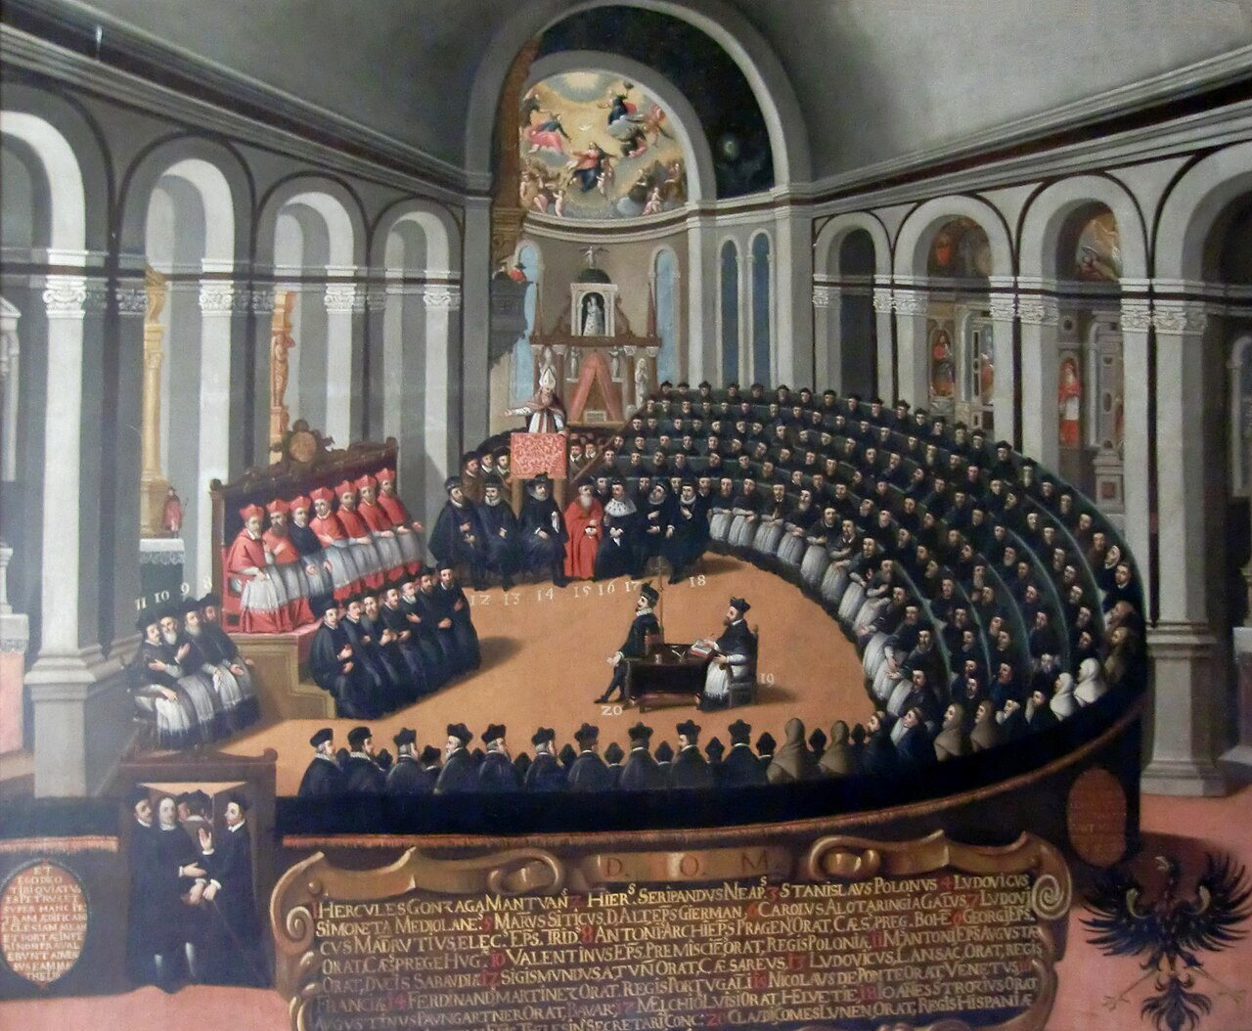
Incorporated Into Christ | Galatians 3:15-29
  Catholic Counter Reformation:
  The Council of Trent

Slide 16
Incorporated Into Christ | Galatians 3:15-29
There is neither Jew nor Gentile, neither slave nor free, nor is there male and female, for you are all one in Christ Jesus.
Galatians 3:28

Slide 17
Incorporated Into Christ | Galatians 3:15-29
If you belong to Christ, then you are Abraham’s seed, and heirs according to the promise.
Galatians 3:29

Slide 18
Incorporated Into Christ | Galatians 3:15-29
Incorporated into Christ
The Promise Is Fulfilled In Christ
The Law Leads Us To Christ
The Believer Is Clothed With Christ

