Slide 1
  No Longer A Slave
  Galatians 4:1-7

Slide 2
No Longer A Slave | Galatians 4:1-7
So you are no longer a slave, but a son, and if a son, then an heir through God.
Galatians 4:7 (ESV)

Slide 3
No Longer A Slave | Galatians 4:1-7
An Heir Through God
Recognize What Has Mastered You

Slide 4
No Longer A Slave | Galatians 4:1-7
What I am saying is that as long as an heir is underage, he is no different from a slave, although he owns the whole estate. ² The heir is subject to guardians and trustees until the time set by his father. ³ So also, when we were underage, we were in slavery under the elemental spiritual forces of the world.
Galatians 4:1-3

Slide 5
No Longer A Slave | Galatians 4:1-7
What I am saying is that as long as an heir is underage, he is no different from a slave, although he owns the whole estate. ² The heir is subject to guardians and trustees until the time set by his father. ³ So also, when we were underage, we were in slavery under the elemental spiritual forces of the world.
Galatians 4:1-3

Slide 6
No Longer A Slave | Galatians 4:1-7
Elemental Spiritual Forces Of The World
Money
Sex
Power

Slide 7
No Longer A Slave | Galatians 4:1-7
⁴ But when the set time had fully come, God sent his Son, born of a woman, born under the law, ⁵ to redeem those under the law, that we might receive adoption to sonship.
Galatians 4:4-5

Slide 8
No Longer A Slave | Galatians 4:1-7
An Heir Through God
Recognize What Has Mastered You
Receive What Christ Has Done

Slide 9
No Longer A Slave | Galatians 4:1-7
See what kind of love the Father has given to us, that we should be called children of God; and so we are. The reason why the world does not know us is that it did not know him.
1 John 3:1 (ESV)

Slide 10
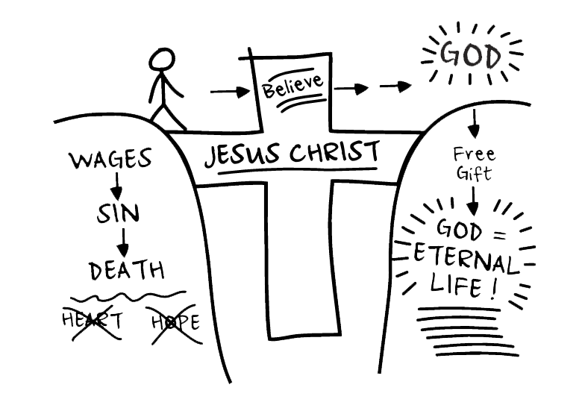

Slide 11
No Longer A Slave | Galatians 4:1-7
Because you are his sons, God sent the Spirit of his Son into our hearts, the Spirit who calls out, “Abba, Father.”
Galatians 4:6

Slide 12
No Longer A Slave | Galatians 4:1-7
An Heir Through God
Recognize What Has Mastered You
Receive What Christ Has Done
Cry Out to God as Father

Slide 13
No Longer A Slave | Galatians 4:1-7
The Spirit you received does not make you slaves, so that you live in fear again; rather, the Spirit you received brought about your adoption to sonship. And by him we cry, “Abba, Father.”
Romans 8:15

Slide 14
No Longer A Slave | Galatians 4:1-7
An Heir Through God
Recognize What Has Mastered You
Receive What Christ Has Done
Cry Out to God as Father

Slide 15
No Longer A Slave | Galatians 4:1-7
So you are no longer a slave, but God’s child; and since you are his child, God has made you also an heir.
Galatians 4:7

Slide 16
No Longer A Slave | Galatians 4:1-7
An Heir Through God
Recognize What Has Mastered You
Receive What Christ Has Done
Cry Out to God as Father
Live as God’s Heir

Slide 17
No Longer A Slave | Galatians 4:1-7
Endure hardship as discipline; God is treating you as his children. For what children are not disciplined by their father?
Hebrews 12:7

Slide 18
No Longer A Slave | Galatians 4:1-7
No discipline seems pleasant at the time, but painful. Later on, however, it produces a harvest of righteousness and peace for those who have been trained by it.
Hebrews 12:11

Slide 19


Slide 20
Lord Jesus, I thank You for dying on the cross for me and I acknowledge (accept) You as my Saviour. “In view of God’s mercy, I choose to offer my body, soul and spirit as a living sacrifice, holy and pleasing to You – this is my spiritual act of worship.
Lordship Prayer

Slide 21
I choose to no longer conform to the pattern of this world, but to be transformed by the renewing of my mind. For then I will be able to test and approve what Your will is – Your good, pleasing and perfect will.
So I invite You now to be Lord of every area of my life, releasing my control and giving you full reign and possession of everything.
Lordship Prayer

Slide 22
I ask You to be Lord of my SPIRIT
Lord of my relationship with You;
Lord of my spiritual awareness and conscience;
Lord of my creativity and my spiritual gifts;
Lord of my worship;
Lord of my identity and who I am in You.
Lordship Prayer

Slide 23
I ask You to be Lord of my SOUL
Lord of my MIND, my attitudes, my beliefs, my imagination, my dreams and all my thoughts;
Lord of my EMOTIONS, my expression of my feelings and all my reactions;
Lord of my WILL and all my decisions (conscious, subconscious and unconscious)
Lord of my defense mechanisms, coping mechanism and my behaviour cycles.
Lordship Prayer

Slide 24
I ask You to be Lord of my BODY
Lord of my physical health, my exercise, my rest, my appearance and all my physical behaviour;
Lord of my eyes and what I look upon;
Lord of my ears and everything I listen to;
Lord of my mouth and what I speak and eat;
Lord of my hands and all that I do and touch;
Lord of my feet and everywhere I go;
Lord of my sexuality and its expression.
Lordship Prayer

Slide 25
I ask You to be Lord of my PERSONAL LIFE
Lord of my family (spouse, children, etc.) and my home;
Lord of my possessions, my perceived needs, my finances;
Lord of my time, my work, my ministry, my pleasure;
Lord of my plans, my ambitions, my future, my destiny;
Lord of all my relationships.
Lordship Prayer

Slide 26
Thank you Lord Jesus that your blood was shed for me that I might be free. Amen.
Lordship Prayer

Slide 27
No Longer A Slave | Galatians 4:1-7
An Heir Through God
Recognize What Has Mastered You
Receive What Christ Has Done
Cry Out to God as Father
Live as God’s Heir

