Slide 1
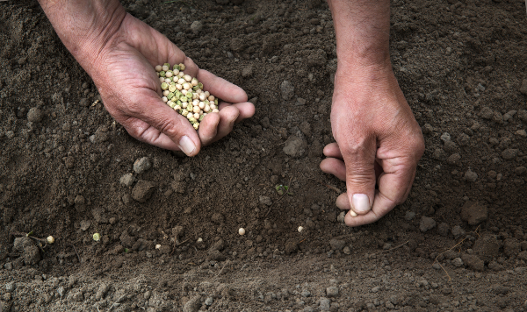
Forgetting Yourself
Galatians 6:6–10

Slide 2
Depend on Yourself
Salvation

Slide 3
Depend on Yourself
Salvation
Judaism
Circumcision
Keeping the Law

Slide 4
Depend on Yourself
Salvation
Judaism
Islam
Circumcision
Keeping the Law
Circumcision
Keeping the Law

Slide 5
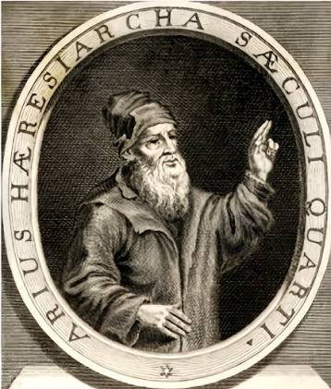
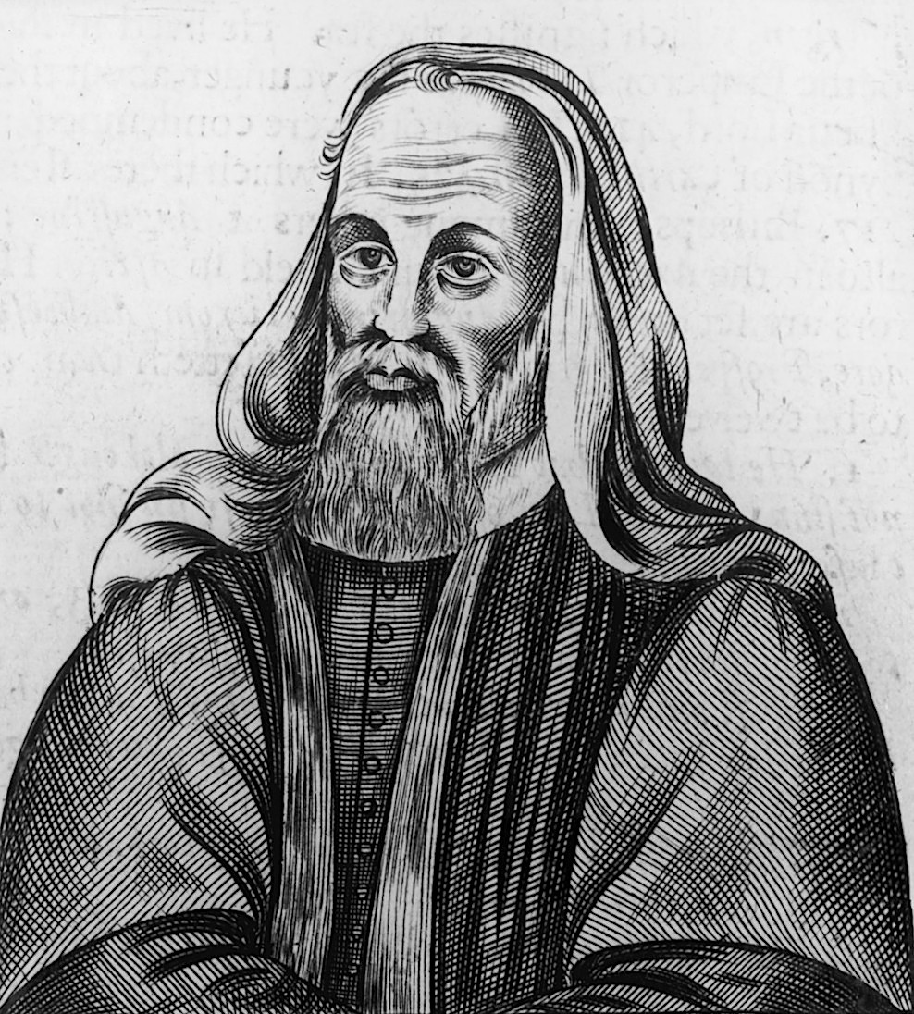
Depend on Yourself
Salvation
Judaism
Islam
Christian Heresies
Arius
Pelagius
Circumcision
Keeping the Law
Circumcision
Keeping the Law
Perfect Human Obedience
Humans Choose to Believe

Slide 6
Depend on Yourself
Salvation
Judaism
Islam
Christian Heresies
Arius
Pelagius
Circumcision
Keeping the Law
Circumcision
Keeping the Law
Depend on Yourself
Perfect Human Obedience
Humans Choose to Believe

Slide 7
Depend on Yourself
Salvation

Slide 8
Depend on Yourself
Salvation
Inferiority

Slide 9
Depend on Yourself
Salvation
Inferiority
Pride

Slide 10
Depend on Yourself
Salvation
Inferiority
Pride
5:15 “If you bite and devour each other, watch out or you will be destroyed by each other.”
5:26 “Let us not become conceited, provoking and envying each other.”

Slide 11
Faith
Works
VS

Slide 12
Faith
Romans
Galatians
Ephesians
Works
James
The Gospels
(Sermon on the Mount)
VS

Slide 13
Faith
Romans
Galatians
Ephesians
Works
James
The Gospels
(Sermon on the Mount)
VS
From God
From Us
VS

Slide 14
Faith
Romans
Galatians
Ephesians
Works
James
The Gospels
(Sermon on the Mount)
VS
From God
From Us

Slide 15
Faith
Romans
Galatians
Ephesians
Works
James
The Gospels
(Sermon on the Mount)
VS
Arius / Merit
From God
From Us

Slide 16
Faith
Romans
Galatians
Ephesians
Works
James
The Gospels
(Sermon on the Mount)
VS
Arius / Merit
From God
From Us
“There are two kings in my heart.
Let’s see which one is stronger.
One wants me to go to hell.
One wants me to go to heaven.
The devil leads to hell.
The King leads to heaven.
Trust in Jesus and enter heaven.”

Slide 17
Faith
Romans
Galatians
Ephesians
Works
James
The Gospels
(Sermon on the Mount)
VS
Arius / Merit
The Will Is Not Free
From God
From Us
“For it is by grace you have been saved, through faith—and this
is not from yourselves, it is the gift of God.” (Ephesians 2:8)

Slide 18
Faith
Romans
Galatians
Ephesians
Works
James
The Gospels
(Sermon on the Mount)
VS
From God
From Us
The Faithful God

Slide 19
Faith
Romans
Galatians
Ephesians
Works
James
The Gospels
(Sermon on the Mount)
VS
From God
From Us
The Faithful God
Fruit of the Spirit
God’s Good Works
The Spirit’s Good Works
Fruit of the Spirit

Slide 20
Faith
Works
VS
From God
From Us
VS
Galatian Churches
Moralism
“How you understand the problem decides the answer you seek.”

Slide 21
I
I get it.
I’ve got it.
I know what to do next.
My faith
My good works
God

Slide 22
I
I’m finished!
I get it.
I’ve got it.
I know what to do next.
My faith
My good works
God

Slide 23
For sinners living in darkness, nothing is more devastating than the truth of the gospel.
And nothing is more gentle than the truth of the gospel.
Before God, there are only two ways forward.
One is to die in shame and despair.
The other is to accept, with gratitude, that you have already been accepted.

Slide 24
6:6 “The one who receives instruction in the word should share all good things with their instructor.”

Slide 25
6:6 “The one who receives instruction in the word should share all good things with their instructor.”
Because God faithfully provides, you are free to give, to serve, and to lay yourself down for others. Together, we carry one another’s burdens.
The gospel transforms the way we understand money and power.

Slide 26
6:6
“The one who receives instruction in the word should share (koinonia, Fellowship) all good things with their instructor.”

Slide 27
6:6
“The one who receives instruction in the word should share (koinonia, Fellowship) all good things with their instructor.”
Everything is a gift. Everything is grace! The gift of teaching, courage to stand for truth, generous giving, a humble heart to learn, and faithfulness to the gospel—all are grace.
When you realise that everything you have is grace, you understand what giving really means.

Slide 28
6:7 “Do not be deceived: God cannot be mocked. A man reaps what he sows.”
6:8 “Whoever sows to please their flesh, from the flesh will reap destruction; whoever sows to please the Spirit, from the Spirit will reap eternal life.”
Galatians 5
Spirit VS Flesh
Fruit of the Spirit
Sow to the Spirit VS Sow to the Flesh
Galatians 6

Slide 29

Lawn

Slide 30
6:7 “Do not be deceived: God cannot be mocked. A man reaps what he sows.”
6:8 “Whoever sows to please their flesh, from the flesh will reap destruction; whoever sows to please the Spirit, from the Spirit will reap eternal life.”
Galatians 5
Spirit VS Flesh
Fruit of the Spirit
Galatians 6
Sow to the Spirit VS Sow to the Flesh

Slide 31
6:7 “Do not be deceived: God cannot be mocked. A man reaps what he sows.”
6:8 “Whoever sows to please their flesh … whoever sows to please the Spirit …”
6:9 “Let us not become weary in doing good, for at the proper time (kairos) we will reap a harvest if we do not give up.”
6:10 “Therefore, as we have opportunity (kairos), let us do good to all people, especially to those who belong to the family of believers.”

Slide 32
6:7 “Do not be deceived: God cannot be mocked. A man reaps what he sows.”
6:8 “Whoever sows to please their flesh … whoever sows to please the Spirit …”
6:9 “Let us not become weary in doing good, for at the proper time (kairos) we will reap a harvest if we do not give up.”
6:10 “Therefore, as we have opportunity (kairos), let us do good to all people, especially to those who belong to the family of believers.”
My Faith
My Good Works
My Timing
God’s Faithfulness
The Spirit’s Work
God’s Timing

Slide 33
Forgetting Yourself
Galatians 6:6–10

