Slide 1

  The New Creation
  Galatians 6:11-18

Slide 2
The New Creation | Galatians 6:11-18
See what large letters I use as I write to you with my own hand!
Galatians 6:11

Slide 3
The New Creation | Galatians 6:11-18
From now on, let no one cause me trouble, for I bear on my body the marks of Jesus.
Galatians 6:17

Slide 4
The New Creation | Galatians 6:11-18
Neither circumcision nor uncircumcision means anything; what counts is the new creation.
Galatians 6:15

Slide 5
The New Creation | Galatians 6:11-18
The New Creation
New birth

Slide 6
The New Creation | Galatians 6:11-18
Those who want to impress people by means of the flesh are trying to compel you to be circumcised. The only reason they do this is to avoid being persecuted for the cross of Christ. Not even those who are circumcised keep the law, yet they want you to be circumcised that they may boast about your circumcision in the flesh.
Galatians 6:12-13

Slide 7
The New Creation | Galatians 6:11-18
The New Creation
New birth - by grace

Slide 8
The New Creation | Galatians 6:11-18
to redeem those under the law, that we might receive adoption to sonship.
Galatians 4:5

Slide 9


Slide 10
The New Creation | Galatians 6:11-18
The New Creation
New birth - by grace
New purpose

Slide 11
The New Creation | Galatians 6:11-18
May I never boast except in the cross of our Lord Jesus Christ, through which the world has been crucified to me, and I to the world.
Galatians 6:14

Slide 12
The New Creation | Galatians 6:11-18
The New Creation
New birth - by grace
New purpose - for freedom

Slide 13
The New Creation | Galatians 6:11-18
It is for freedom that Christ has set us free…
Galatians 5:1

Slide 14
The New Creation | Galatians 6:11-18
So you are no longer a slave, but God’s child; and since you are his child, God has made you also an heir.
Galatians 4:7

Slide 15
The New Creation | Galatians 6:11-18
The New Creation
New birth - by grace
New purpose - for freedom
New lifestyle

Slide 16
The New Creation | Galatians 6:11-18
Peace and mercy to all who follow this rule - to the Israel of God.
Galatians 6:16

Slide 17
The New Creation | Galatians 6:11-18
Carry each other’s burdens, and in this way you will fulfill the law of Christ.
Galatians 6:2

Slide 18
The New Creation | Galatians 6:11-18
The New Creation
New birth - by grace
New purpose - for freedom
New lifestyle - by the Spirit

Slide 19
The New Creation | Galatians 6:11-18
For the entire law is fulfilled in keeping this one command: “Love your neighbor as yourself.”
Galatians 5:14

Slide 20
The New Creation | Galatians 6:11-18
Therefore, as we have opportunity, let us do good to all people, especially to those who belong to the family of believers.
Galatians 6:10

Slide 21
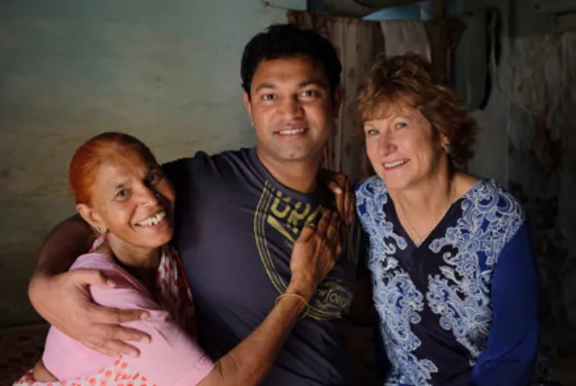

Slide 22
The New Creation | Galatians 6:11-18
The New Creation
New birth - by grace
New purpose - for freedom
New lifestyle - by the Spirit

