Slide 1
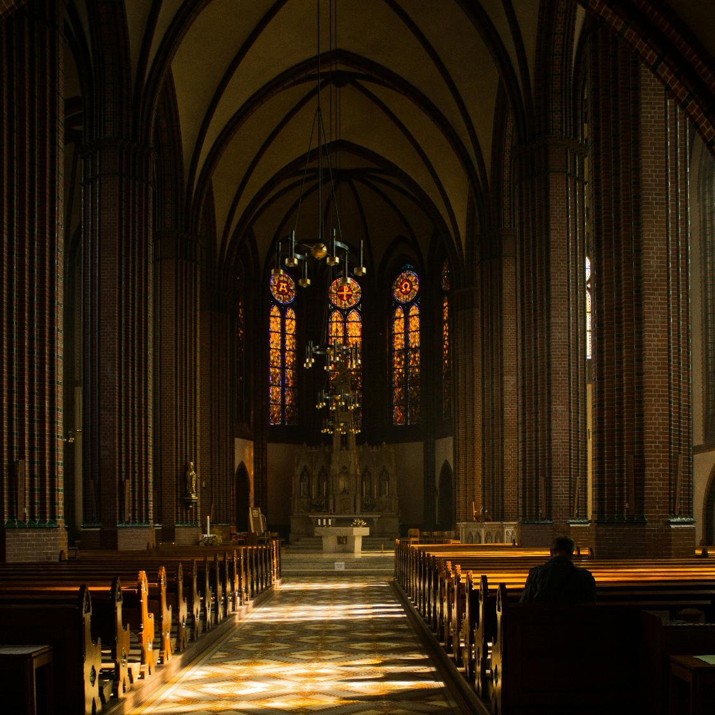
  A Heritage of Faith
  2 Timothy 1:1-5

Slide 2
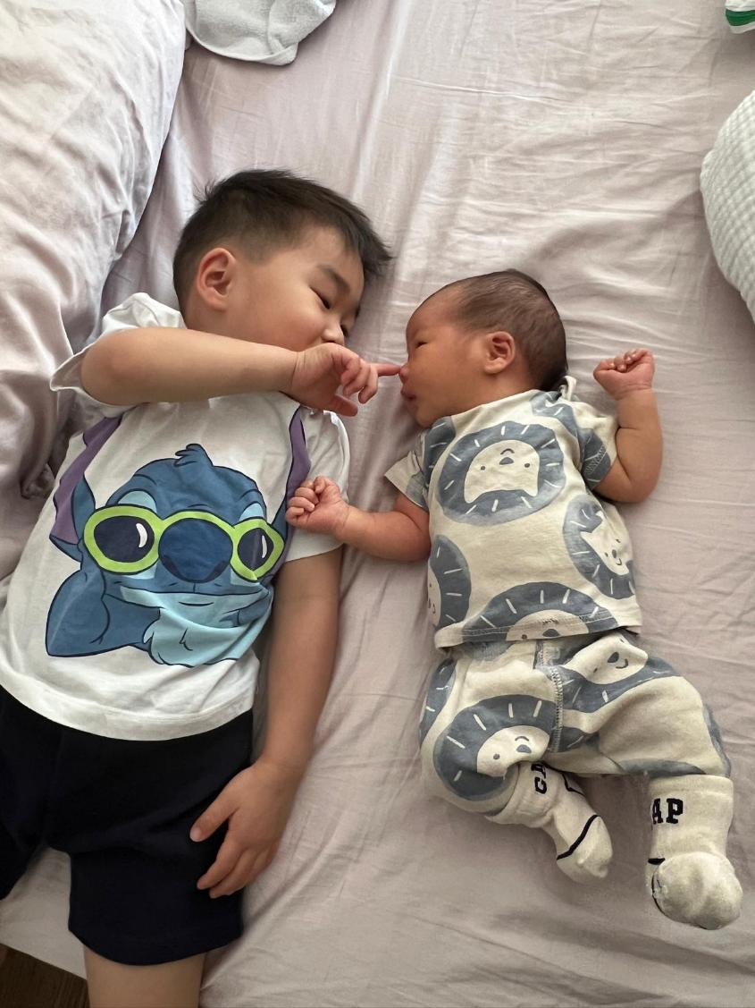

Slide 3
  A Heritage of Faith
  2 Timothy 1:1-5

Slide 4
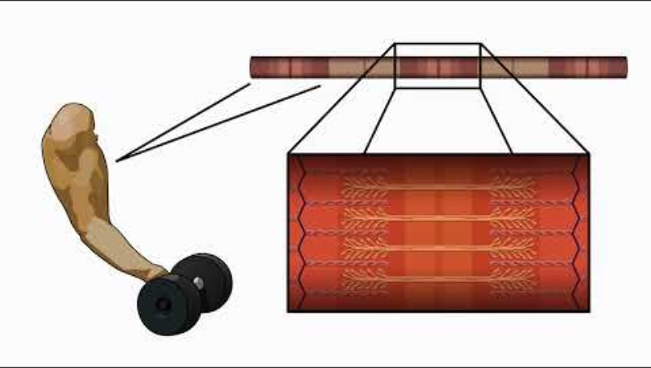

Slide 5
A Heritage of Faith | 2 Timothy 1:1-5
The faith we have received was exemplified by those who came before us, embodied in faithful relationships, and entrusted to us for those who will come after us.

Slide 6
A Heritage of Faith | 2 Timothy 1:1-5
I thank God, whom I serve, as my ancestors did, with a clear conscience, as night and day I constantly remember you in my prayers.
2 Timothy 1:3

Slide 7
A Heritage of Faith | 2 Timothy 1:1-5
Heritage
of Faith
Remember the Faith Before You

Slide 8
A Heritage of Faith | 2 Timothy 1:1-5
Recalling your tears, I long to see you, so that I may be filled with joy.
2 Timothy 1:4

Slide 9
A Heritage of Faith | 2 Timothy 1:1-5
Heritage
of Faith
Remember the Faith Before You
Treasure the People Beside You

Slide 10
A Heritage of Faith | 2 Timothy 1:1-5
Resilient Disciples on Intergenerational Community:
“I feel valued by the people in my life who are older than me.”
“I welcome positive criticism from those who are older than me.”
“I often look to those who are older than me for advice when I need to make difficult decisions.”

Slide 11
A Heritage of Faith | 2 Timothy 1:1-5
Resilient Disciples on Intergenerational Community:
“I feel valued by the people in my life who are older than me.”
“I welcome positive criticism from those who are older than me.”
“I often look to those who are older than me for advice when I need to make difficult decisions.”

Slide 12
A Heritage of Faith | 2 Timothy 1:1-5
I am reminded of your sincere faith, which first lived in your grandmother Lois and in your mother Eunice and, I am persuaded, now lives in you also.
2 Timothy 1:5

Slide 13
A Heritage of Faith | 2 Timothy 1:1-5
Heritage
of Faith
Remember the Faith Before You
Treasure the People Beside You
Prepare the Generation After You

Slide 14
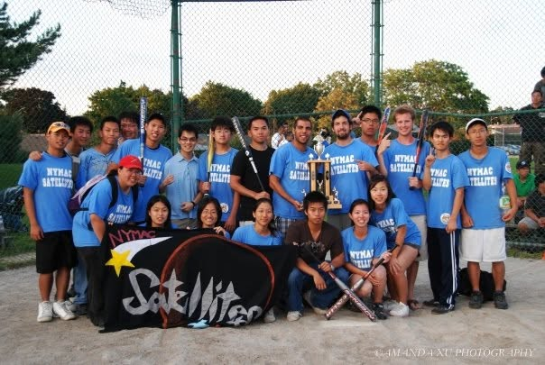
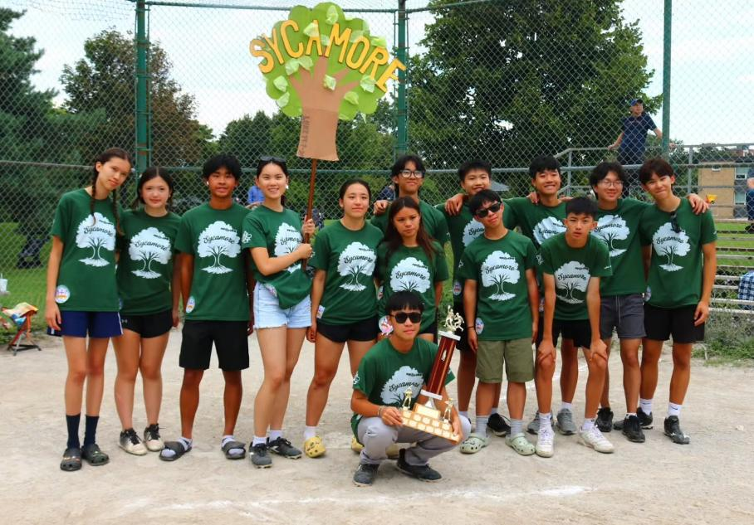

Slide 15
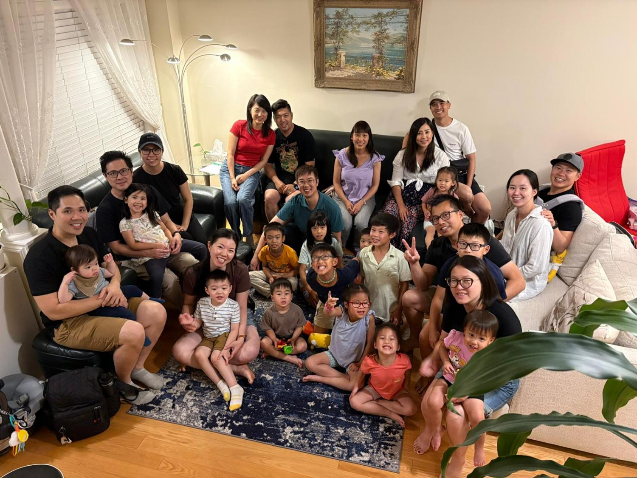

Slide 16
A Heritage of Faith | 2 Timothy 1:1-5
Heritage
of Faith
Remember the Faith Before You - Gratitude
Treasure the People Beside You –
Love
Prepare the Generation After You – Responsibility

