Slide 1

  Faithful Under Pressure
  2 Timothy 1:6-18

Slide 2



Slide 3
  Faithful Under Pressure
  2 Timothy 1:6-18

Slide 4
Faithful Under Pressure | 2 Timothy 1:6-8
Guard the good deposit that was entrusted to you—guard it with the help of the Holy Spirit who lives in us.
2 Timothy 1:14

Slide 5
Faithful Under Pressure | 2 Timothy 1:6-8
For this reason I remind you to fan into flame the gift of God, which is in you through the laying on of my hands. For the Spirit God gave us does not make us timid, but gives us power, love and self-discipline.
2 Timothy 1:6-7

Slide 6
Faithful Under Pressure | 2 Timothy 1:6-8
Faithful Under Pressure
Stir Up The Gift (vv. 6-7)

Slide 7
Faithful Under Pressure | 2 Timothy 1:6-8
Wenlung Yeh (Vice Chair & English)
Kevin Wang (Treasurer & Finance)
Vincent Wang (Fellowships)
Eva Zhong (Music Director)
Bin-Shin So (Hospitality)
Kevin Wang (Mustard Seed)
Bronco Lam (Light)
Jonny Wang (Vineyard)
Benjamin Yeh (Sycamore)

Slide 8
Faithful Under Pressure | 2 Timothy 1:6-8
⁸ So do not be ashamed of the testimony about our Lord or of me his prisoner. Rather, join with me in suffering for the gospel, by the power of God. ⁹ He has saved us and called us to a holy life—not because of anything we have done but because of his own purpose and grace. This grace was given us in Christ Jesus before the beginning of time, ¹⁰ but it has now been revealed through the appearing of our Savior, Christ Jesus, who has destroyed death and has brought life and immortality to light through the gospel.
2 Timothy 1:8-10

Slide 9
Faithful Under Pressure | 2 Timothy 1:6-8
⁸ So do not be ashamed of the testimony about our Lord or of me his prisoner. Rather, join with me in suffering for the gospel, by the power of God. ⁹ He has saved us and called us to a holy life—not because of anything we have done but because of his own purpose and grace. This grace was given us in Christ Jesus before the beginning of time, ¹⁰ but it has now been revealed through the appearing of our Savior, Christ Jesus, who has destroyed death and has brought life and immortality to light through the gospel.
2 Timothy 1:8-10

Slide 10
Faithful Under Pressure | 2 Timothy 1:6-8
⁸ So do not be ashamed of the testimony about our Lord or of me his prisoner. Rather, join with me in suffering for the gospel, by the power of God. ⁹ He has saved us and called us to a holy life—not because of anything we have done but because of his own purpose and grace. This grace was given us in Christ Jesus before the beginning of time, ¹⁰ but it has now been revealed through the appearing of our Savior, Christ Jesus, who has destroyed death and has brought life and immortality to light through the gospel.
2 Timothy 1:8-10

Slide 11
Faithful Under Pressure | 2 Timothy 1:6-8
¹¹ And of this gospel I was appointed a herald and an apostle and a teacher. ¹² That is why I am suffering as I am. Yet this is no cause for shame, because I know whom I have believed, and am convinced that he is able to guard what I have entrusted to him until that day.
¹³ What you heard from me, keep as the pattern of sound teaching, with faith and love in Christ Jesus. ¹⁴ Guard the good deposit that was entrusted to you—guard it with the help of the Holy Spirit who lives in us.
2 Timothy 1:11-14

Slide 12
Faithful Under Pressure | 2 Timothy 1:6-8
Faithful Under Pressure
Stir Up The Gift (vv. 6-7)
Stand Up For The Gospel (vv. 8-14)

Slide 13
Faithful Under Pressure | 2 Timothy 1:6-8
¹¹ And of this gospel I was appointed a herald and an apostle and a teacher. ¹² That is why I am suffering as I am. Yet this is no cause for shame, because I know whom I have believed, and am convinced that he is able to guard what I have entrusted to him until that day.
¹³ What you heard from me, keep as the pattern of sound teaching, with faith and love in Christ Jesus. ¹⁴ Guard the good deposit that was entrusted to you—guard it with the help of the Holy Spirit who lives in us.
2 Timothy 1:11-14

Slide 14
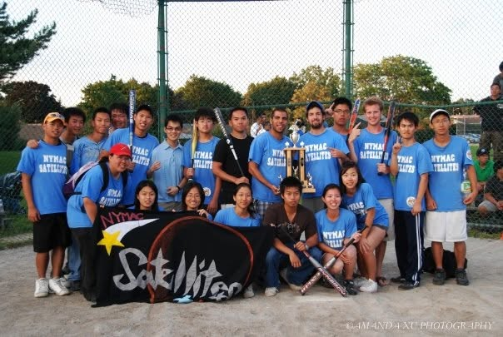

Slide 15
Faithful Under Pressure | 2 Timothy 1:6-8
¹⁵ You know that everyone in the province of Asia has deserted me, including Phygelus and Hermogenes.
¹⁶ May the Lord show mercy to the household of Onesiphorus, because he often refreshed me and was not ashamed of my chains. ¹⁷ On the contrary, when he was in Rome, he searched hard for me until he found me. ¹⁸ May the Lord grant that he will find mercy from the Lord on that day! You know very well in how many ways he helped me in Ephesus.
2 Timothy 1:15-18

Slide 16
Faithful Under Pressure | 2 Timothy 1:6-8
¹⁵ You know that everyone in the province of Asia has deserted me, including Phygelus and Hermogenes.
¹⁶ May the Lord show mercy to the household of Onesiphorus, because he often refreshed me and was not ashamed of my chains. ¹⁷ On the contrary, when he was in Rome, he searched hard for me until he found me. ¹⁸ May the Lord grant that he will find mercy from the Lord on that day! You know very well in how many ways he helped me in Ephesus.
2 Timothy 1:15-18

Slide 17
Faithful Under Pressure | 2 Timothy 1:6-8
Faithful Under Pressure
Stir Up The Gift (vv. 6-7)
Stand Up For The Gospel (vv. 8-14)
Show Up For God’s People (vv. 15-18)

Slide 18
Faithful Under Pressure | 2 Timothy 1:6-8
Faithful Under Pressure
Stir Up The Gift (vv. 6-7)
Stand Up For The Gospel (vv. 8-14)
Show Up For God’s People (vv. 15-18)

