Slide 1
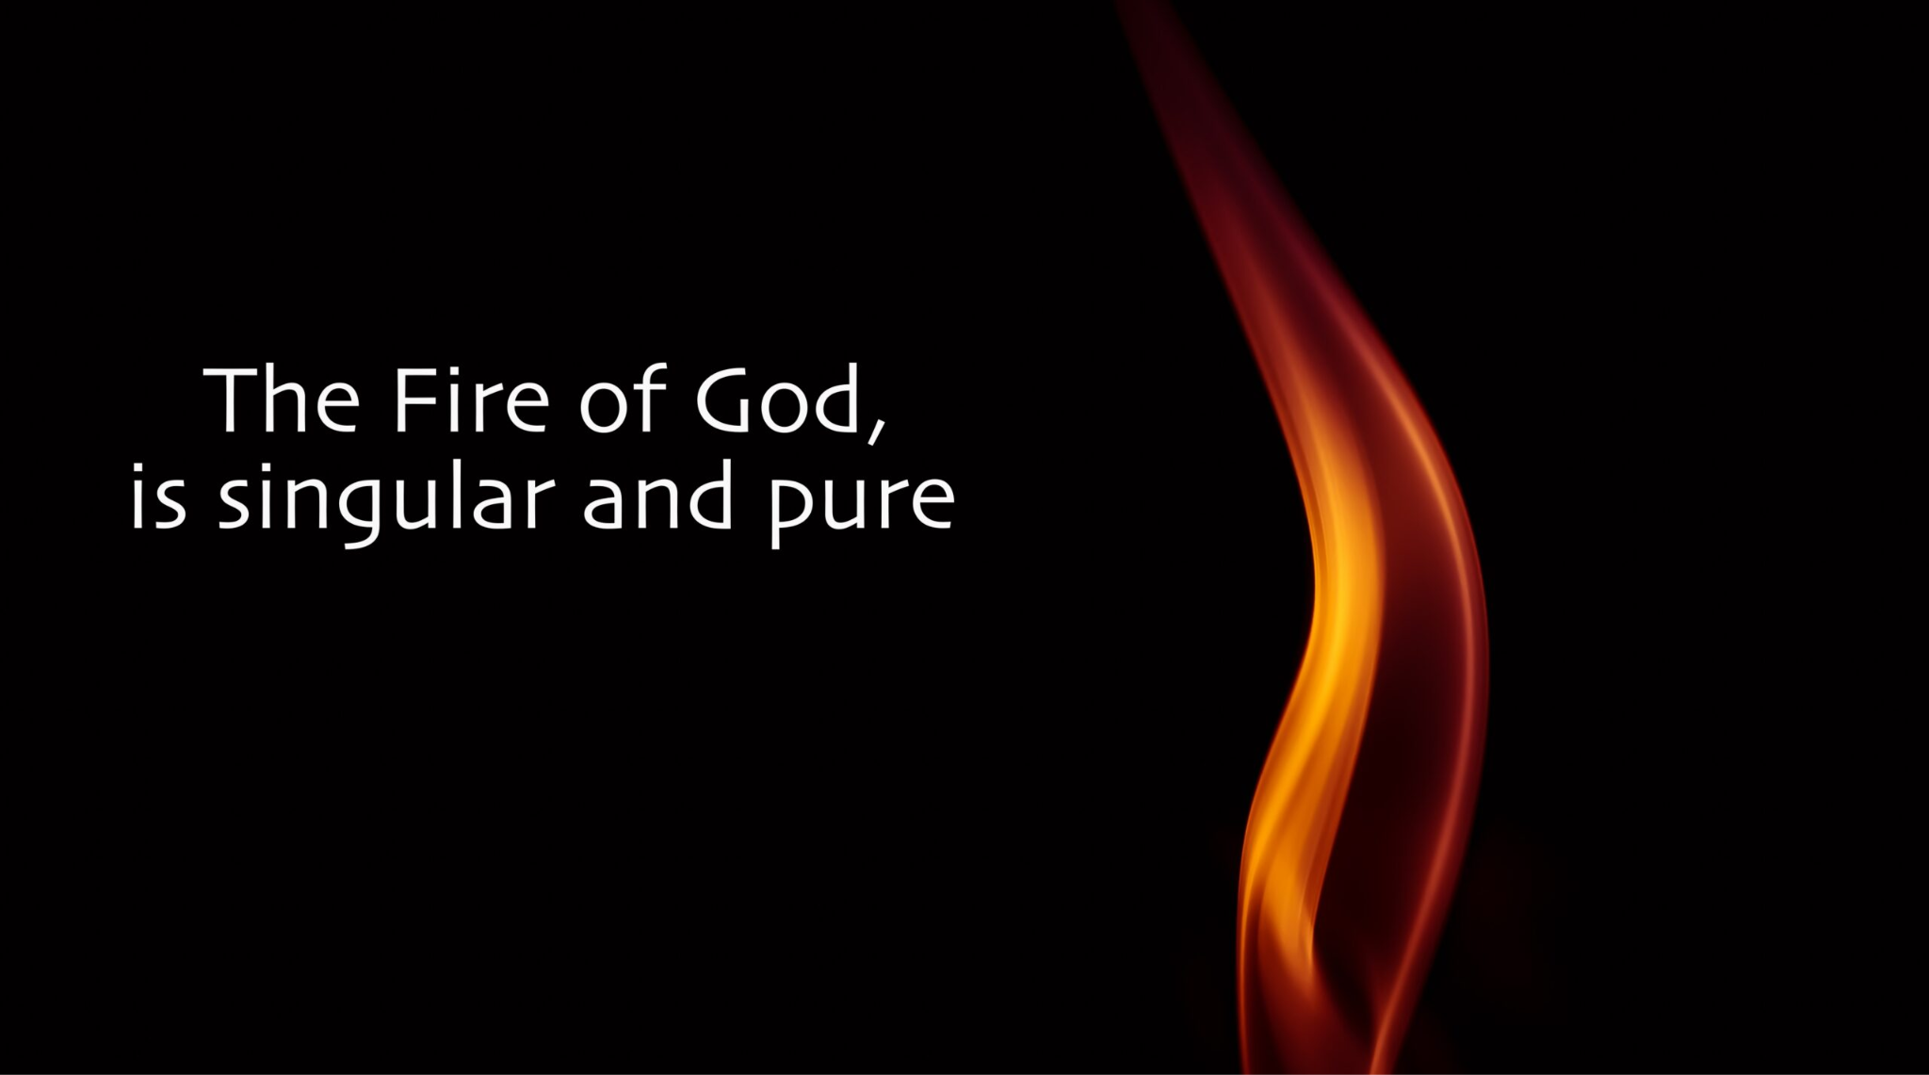
  Spirit Empowered
  Ephesians 5:15-20

Slide 2
Spirit Empowered | Ephesians 5:15-20
Be very careful, then, how you live - not as unwise but as wise, making the most of every opportunity, because the days are evil. Therefore do not be foolish, but understand what the Lord’s will is. Do not get drunk on wine, which leads to debauchery. Instead, be filled with the Spirit,
Ephesians 5:15-18

Slide 3
Spirit Empowered | Ephesians 5:15-20
Be very careful, then, how you live - not as unwise but as wise, making the most of every opportunity, because the days are evil. Therefore do not be foolish, but understand what the Lord’s will is. Do not get drunk on wine, which leads to debauchery. Instead, be filled with the Spirit,
Ephesians 5:15-18

Slide 4
Spirit Empowered | Ephesians 5:15-20
Be very careful, then, how you live - not as unwise but as wise, making the most of every opportunity, because the days are evil. Therefore do not be foolish, but understand what the Lord’s will is. Do not get drunk on wine, which leads to debauchery. Instead, be filled with the Spirit,
Ephesians 5:15-18

Slide 5
Spirit Empowered | Ephesians 5:15-20
Be very careful, then, how you live - not as unwise but as wise, making the most of every opportunity, because the days are evil. Therefore do not be foolish, but understand what the Lord’s will is. Do not get drunk on wine, which leads to debauchery. Instead, be filled with the Spirit,
Ephesians 5:15-18

Slide 6
Spirit Empowered | Ephesians 5:15-20
Be very careful, then, how you live - not as unwise but as wise, making the most of every opportunity, because the days are evil. Therefore do not be foolish, but understand what the Lord’s will is. Do not get drunk on wine, which leads to debauchery. Instead, be filled with the Spirit,
Ephesians 5:15-18

Slide 7
Spirit Empowered | Ephesians 5:15-20
Be very careful, then, how you live - not as unwise but as wise, making the most of every opportunity, because the days are evil. Therefore do not be foolish, but understand what the Lord’s will is. Do not get drunk on wine, which leads to debauchery. Instead, be filled with the Spirit,
Ephesians 5:15-18

Slide 8
Spirit Empowered | Ephesians 5:15-20
Don’t you know that you yourselves are God’s temple and that God’s Spirit dwells in your midst?
1 Corinthians 3:16

Slide 9
Spirit Empowered | Ephesians 5:15-20
Spirit Empowered
Power to do

Slide 10
Spirit Empowered | Ephesians 5:15-20
Spirit Empowered
Power to do – Gifts of the Spirit

Slide 11
Spirit Empowered | Ephesians 5:15-20
There are different kinds of gifts, but the same Spirit distributes them. There are different kinds of service, but the same Lord. There are different kinds of working, but in all of them and in everyone it is the same God at work. Now to each one the manifestation of the Spirit is given for the common good. To one there is given through the Spirit a message of wisdom, to another… All these are the work of one and the same Spirit, and he distributes them to each one, just as he determines.
1 Corinthians 12:4-11

Slide 12
Spirit Empowered | Ephesians 5:15-20
There are different kinds of gifts, but the same Spirit distributes them. There are different kinds of service, but the same Lord. There are different kinds of working, but in all of them and in everyone it is the same God at work. Now to each one the manifestation of the Spirit is given for the common good. To one there is given through the Spirit a message of wisdom, to another… All these are the work of one and the same Spirit, and he distributes them to each one, just as he determines.
1 Corinthians 12:4-11

Slide 13
Spirit Empowered | Ephesians 5:15-20
There are different kinds of gifts, but the same Spirit distributes them. There are different kinds of service, but the same Lord. There are different kinds of working, but in all of them and in everyone it is the same God at work. Now to each one the manifestation of the Spirit is given for the common good. To one there is given through the Spirit a message of wisdom, to another… All these are the work of one and the same Spirit, and he distributes them to each one, just as he determines.
1 Corinthians 12:4-11

Slide 14
Spirit Empowered | Ephesians 5:15-20
There are different kinds of gifts, but the same Spirit distributes them. There are different kinds of service, but the same Lord. There are different kinds of working, but in all of them and in everyone it is the same God at work. Now to each one the manifestation of the Spirit is given for the common good. To one there is given through the Spirit a message of wisdom, to another… All these are the work of one and the same Spirit, and he distributes them to each one, just as he determines.
1 Corinthians 12:4-11

Slide 15
Spirit Empowered | Ephesians 5:15-20
There are different kinds of gifts, but the same Spirit distributes them. There are different kinds of service, but the same Lord. There are different kinds of working, but in all of them and in everyone it is the same God at work. Now to each one the manifestation of the Spirit is given for the common good. To one there is given through the Spirit a message of wisdom, to another… All these are the work of one and the same Spirit, and he distributes them to each one, just as he determines.
1 Corinthians 12:4-11

Slide 16
Spirit Empowered | Ephesians 5:15-20
There are different kinds of gifts, but the same Spirit distributes them. There are different kinds of service, but the same Lord. There are different kinds of working, but in all of them and in everyone it is the same God at work. Now to each one the manifestation of the Spirit is given for the common good. To one there is given through the Spirit a message of wisdom, to another… All these are the work of one and the same Spirit, and he distributes them to each one, just as he determines.
1 Corinthians 12:4-11

Slide 17
Spirit Empowered | Ephesians 5:15-20
Spirit Empowered
Power to do – Gifts of the Spirit
Power to be

Slide 18
Spirit Empowered | Ephesians 5:15-20
Spirit Empowered
Power to do – Gifts of the Spirit
Power to be – Fruit of the Spirit

Slide 19
Spirit Empowered | Ephesians 5:15-20
But the fruit of the Spirit is love, joy, peace, forbearance, kindness, goodness, faithfulness, gentleness and self-control…
Galatians 5:22-23

Slide 20
Spirit Empowered | Ephesians 5:15-20
Be filled with the Spirit

Slide 21
Spirit Empowered | Ephesians 5:15-20
speaking to one another with psalms, hymns, and songs from the Spirit. Sing and make music from your heart to the Lord, always giving thanks to God the Father for everything, in the name of our Lord Jesus Christ.
Ephesians 5:19-20

