Slide 1
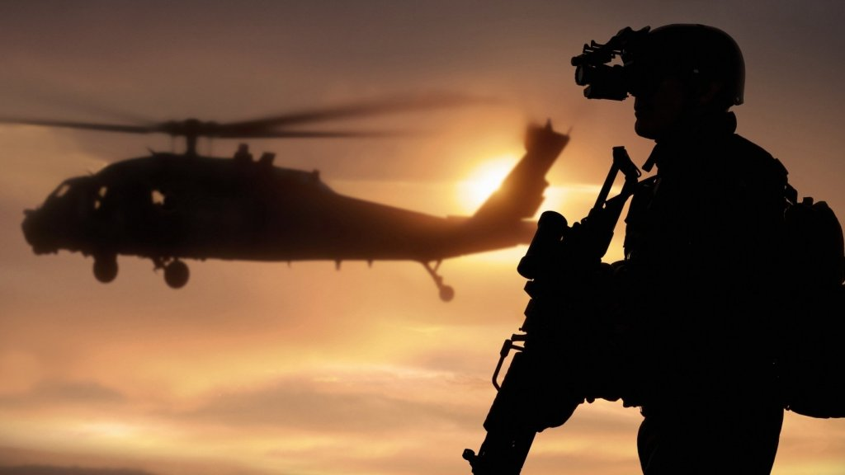
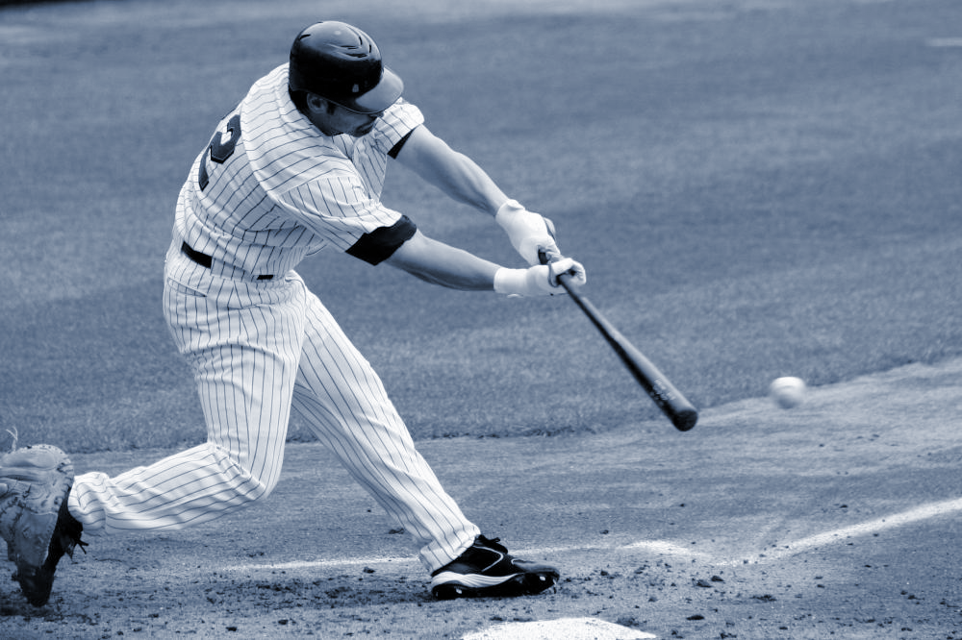
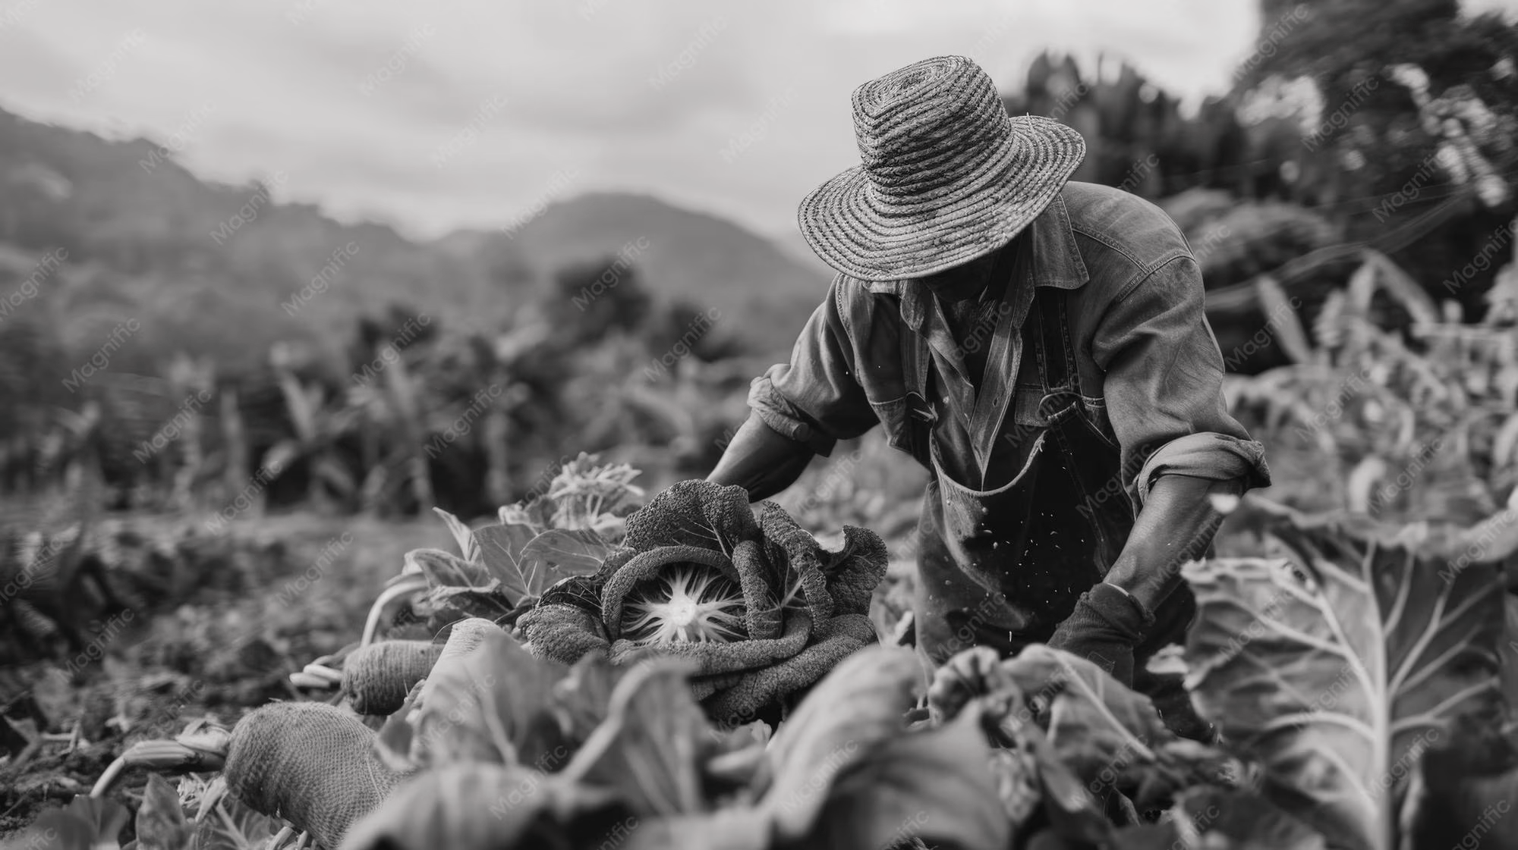
  Strong in Grace
  2 Timothy 2:1-13

Slide 2
Strong in Grace | 2 Timothy 2:1-13
Strong in Grace
SOLDIER
ATHLETE
FARMER

Slide 3
Strong in Grace | 2 Timothy 2:1-13
Strong in Grace
Serve as a SOLDIER

Slide 4
Strong in Grace | 2 Timothy 2:1-13
Join with me in suffering, like a good soldier of Christ Jesus.
2 Timothy 2:3

Slide 5
Strong in Grace | 2 Timothy 2:1-13
…This is my gospel, for which I am suffering even to the point of being chained like a criminal…
2 Timothy 2:8-9

Slide 6
Strong in Grace | 2 Timothy 2:1-13
Strong in Grace
Serve as a SOLDIER

Slide 7
Strong in Grace | 2 Timothy 2:1-13
Strong in Grace
Serve as a SOLDIER for a cause

Slide 8
Strong in Grace | 2 Timothy 2:1-13
No one serving as a soldier gets entangled in civilian affairs, but rather tries to please his commanding officer.
2 Timothy 2:4

Slide 9
Strong in Grace | 2 Timothy 2:1-13
Strong in Grace
Serve as a SOLDIER for a cause - One Lord

Slide 10
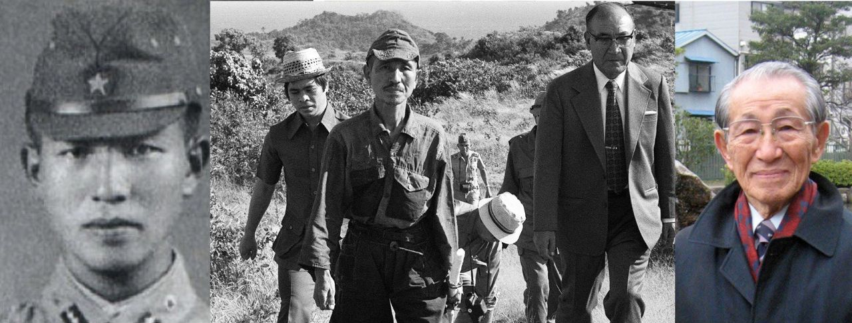

Slide 11
Strong in Grace | 2 Timothy 2:1-13
Strong in Grace
Serve as a SOLDIER for a cause - One Lord

Slide 12
Strong in Grace | 2 Timothy 2:1-13
Strong in Grace
Serve as a SOLDIER for a cause - One Lord
Compete as an ATHLETE

Slide 13
Strong in Grace | 2 Timothy 2:1-13
Similarly, anyone who competes as an athlete does not receive the victor’s crown except by competing according to the rules.
2 Timothy 2:5

Slide 14
Strong in Grace | 2 Timothy 2:1-13
Strong in Grace
Serve as a SOLDIER for a cause - One Lord
Compete as an ATHLETE for the crown

Slide 15
Strong in Grace | 2 Timothy 2:1-13
Similarly, anyone who competes as an athlete does not receive the victor’s crown except by competing according to the rules.
2 Timothy 2:5

Slide 16
Strong in Grace | 2 Timothy 2:1-13
Strong in Grace
Serve as a SOLDIER for a cause - One Lord
Compete as an ATHLETE for the crown - One law

Slide 17
Strong in Grace | 2 Timothy 2:1-13
…rather, serve one another humbly in love. For the entire law is fulfilled in keeping this one command: “Love your neighbor as yourself.”
Galatians 5:13-14

Slide 18
Strong in Grace | 2 Timothy 2:1-13
Serve as a SOLDIER for a cause - One Lord
Compete as an ATHLETE for the crown - One law
Labor as a FARMER for the crops
Strong in Grace

Slide 19
Strong in Grace | 2 Timothy 2:1-13
The hardworking farmer should be the first to receive a share of the crops.
2 Timothy 2:6

Slide 20
Strong in Grace | 2 Timothy 2:1-13
Serve as a SOLDIER for a cause - One Lord
Compete as an ATHLETE for the crown - One law
Labor as a FARMER for the crops - One life
Strong in Grace

Slide 21
Strong in Grace | 2 Timothy 2:1-13
Serve as a soldier for a cause - one Lord
Compete as an athlete for the crown - one law
Labor as a farmer for the crops - one life
Strong in Grace

Slide 22
Strong in Grace | 2 Timothy 2:1-13
Strong in Grace
FAITH
LOVE
HOPE

